Slide 1


FPT SOFTWARE
Machine Learning Fundamentals
10/02/18

Slide 2
Supervised Learning
Lecture 2: Supervised Learning
Outline:
Classification and Regression
Inductive Learning
Decision Trees
Bayesian Learning
Neural Networks
Model Ensembles
Learning Theory
Support Vector Machine
Project Assignment

Slide 3
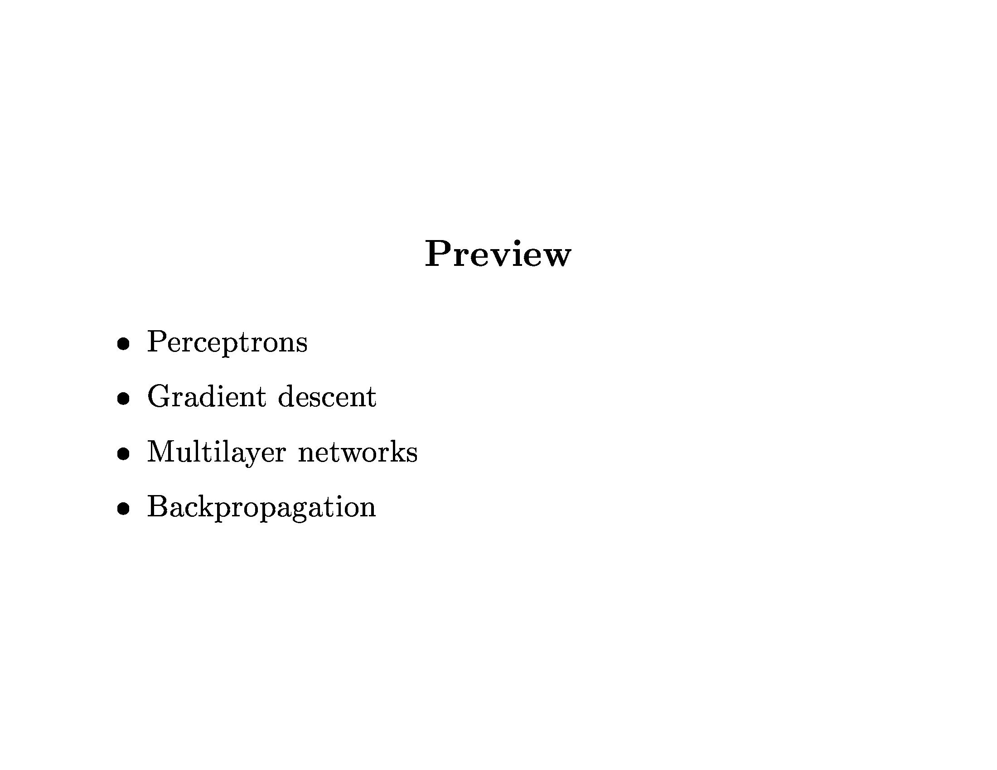
Neural Networks

Slide 4
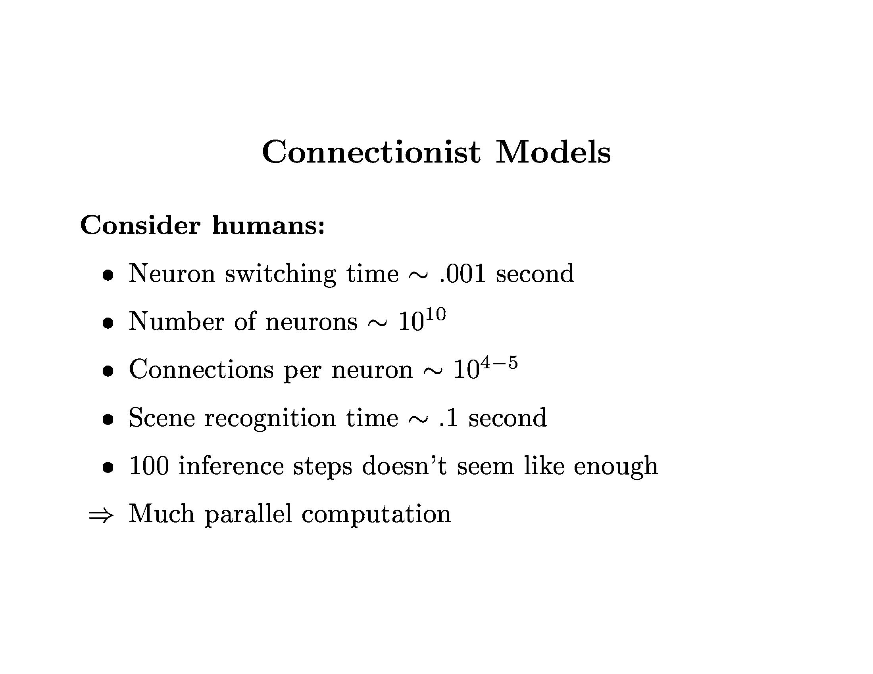
Neural Networks

Slide 5
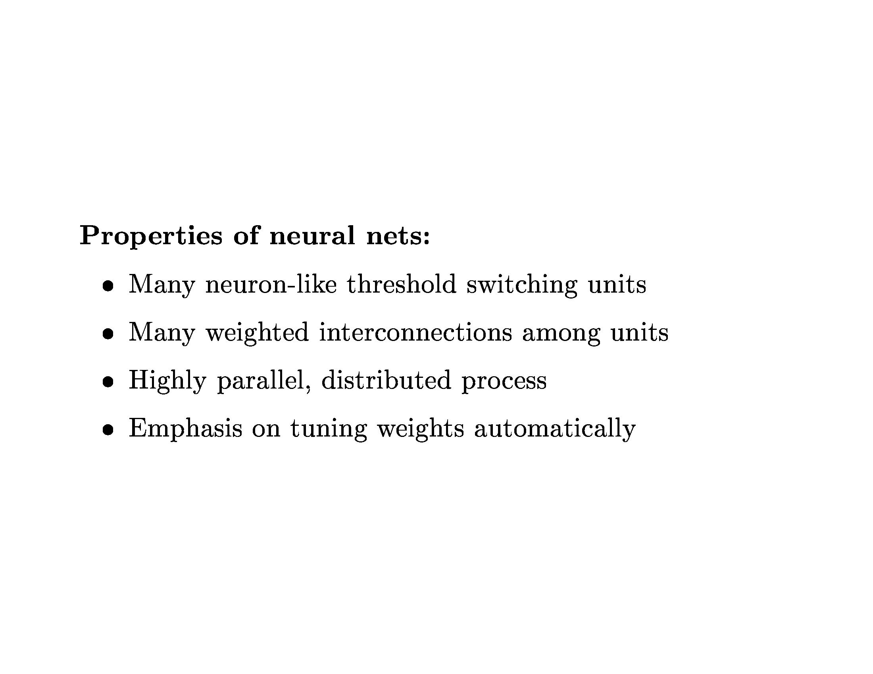
Neural Networks

Slide 6
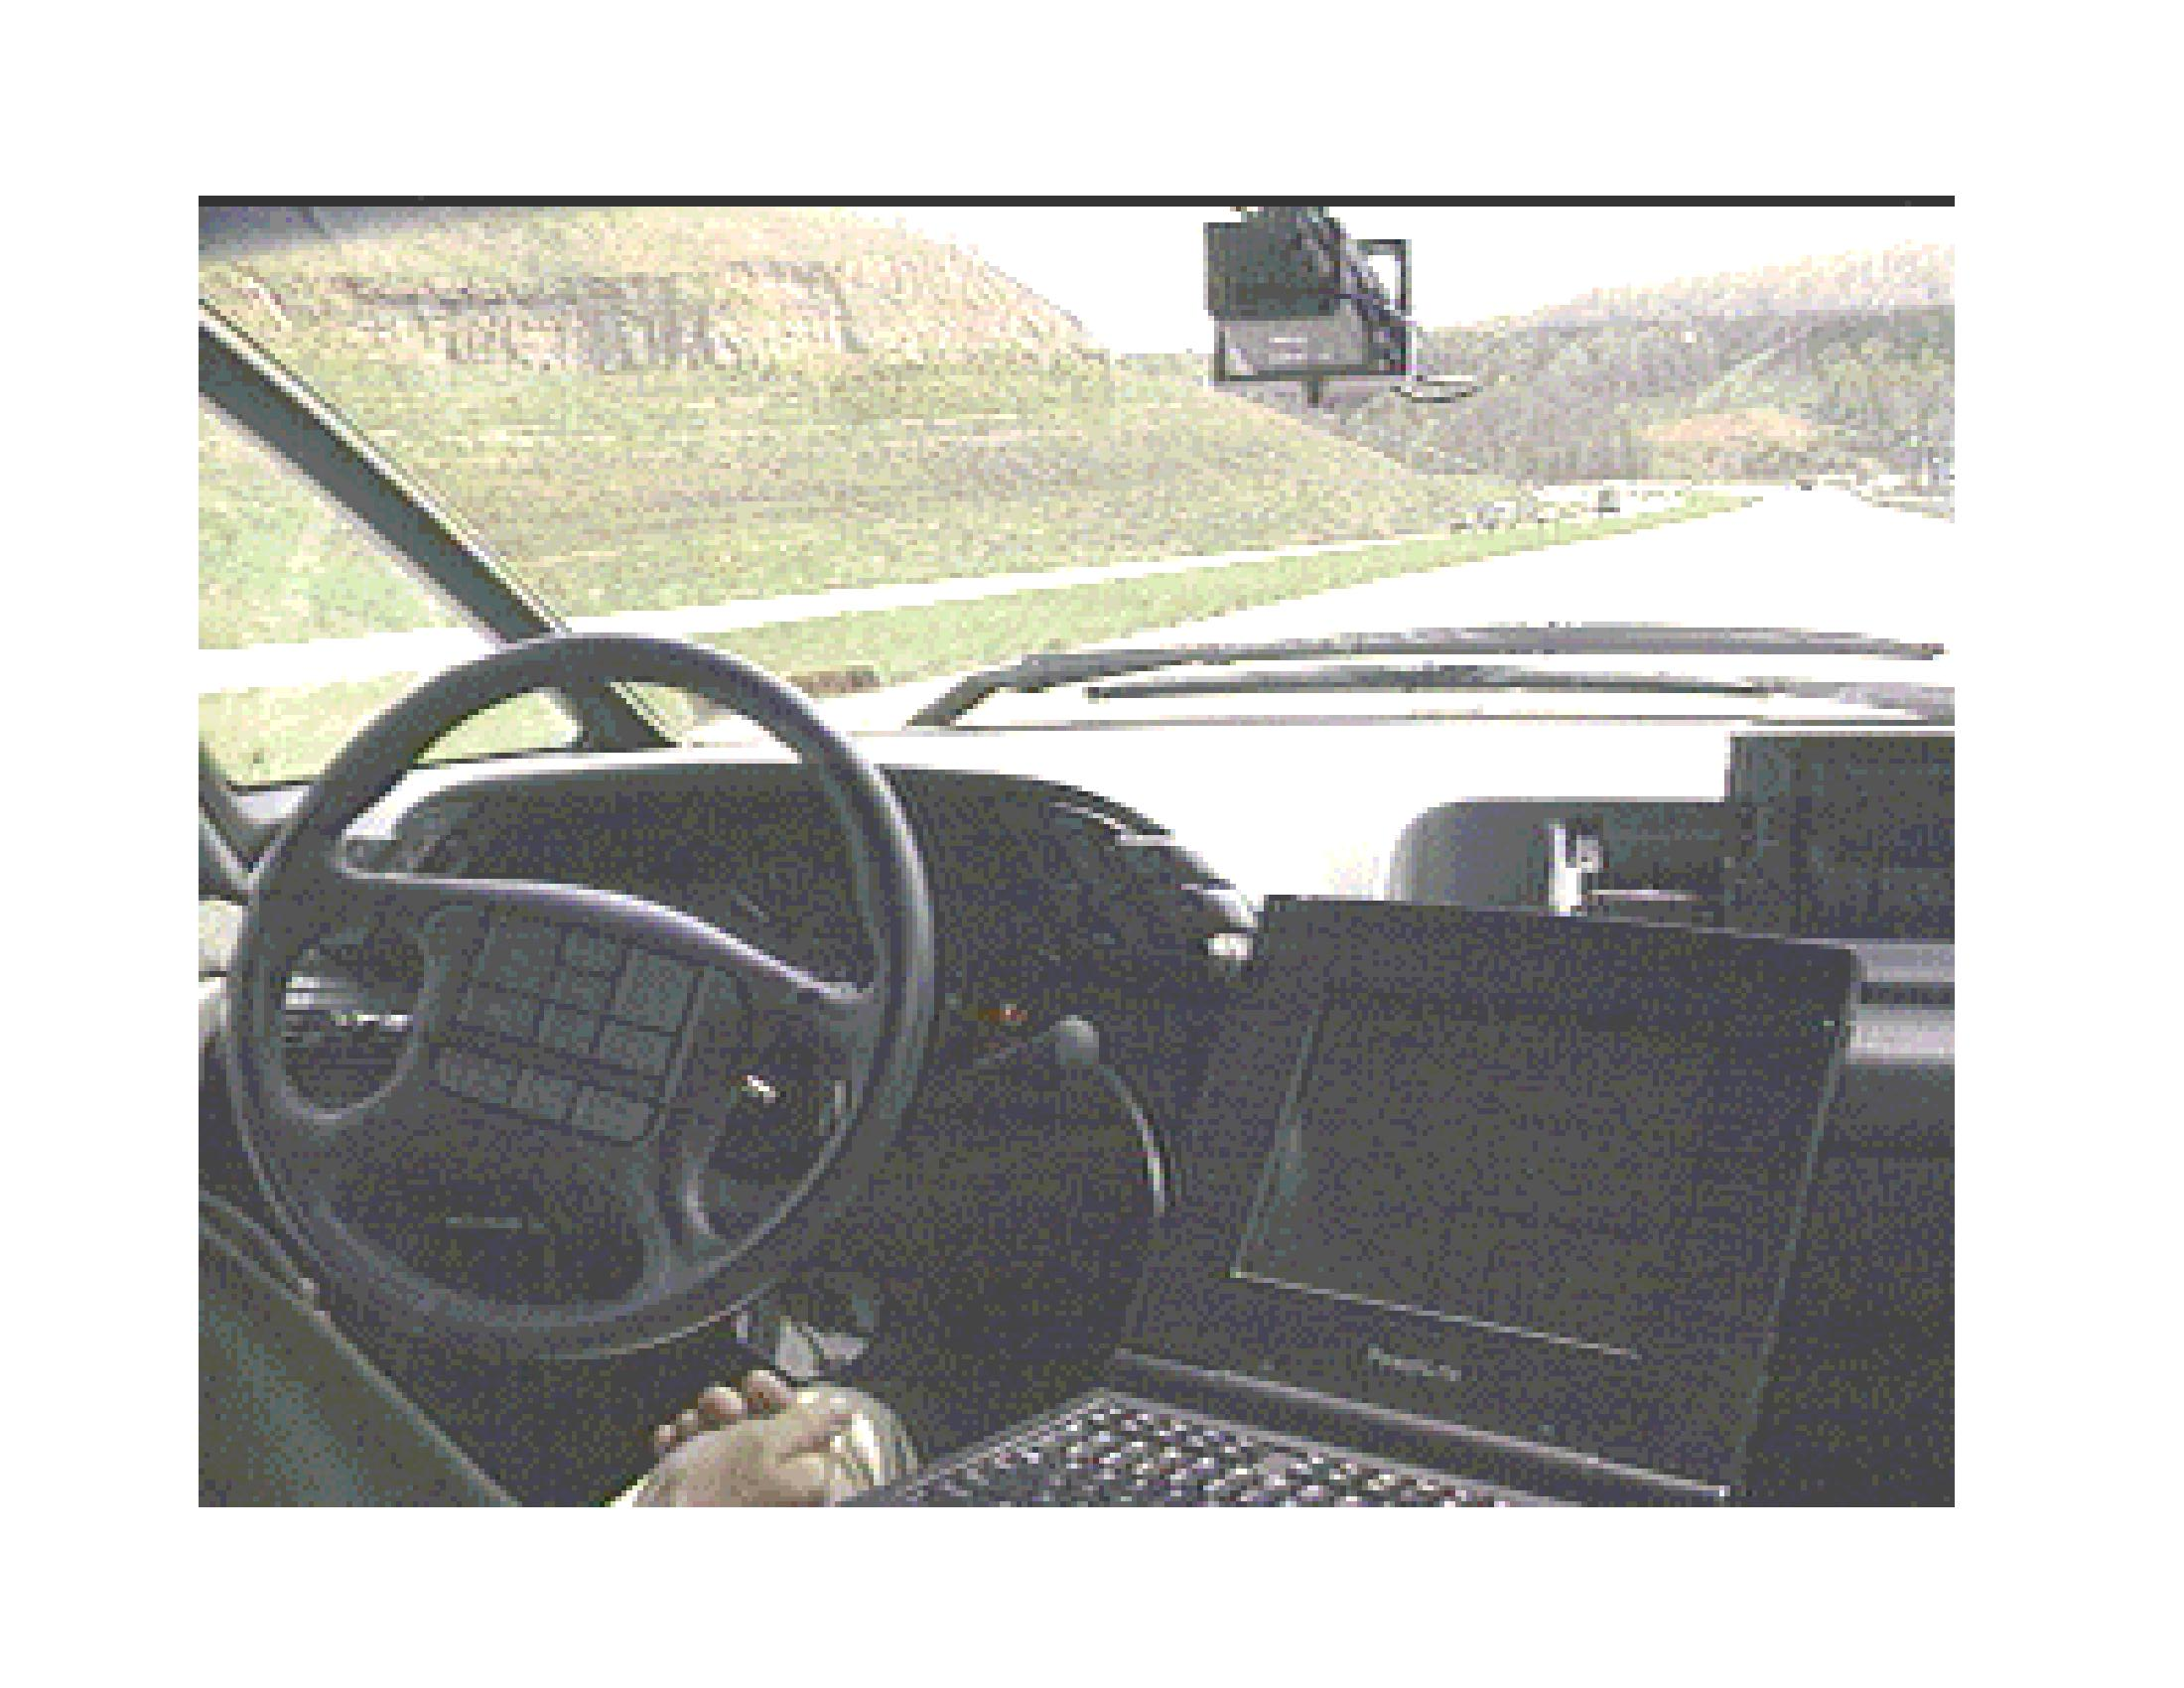
Neural Networks

Slide 7
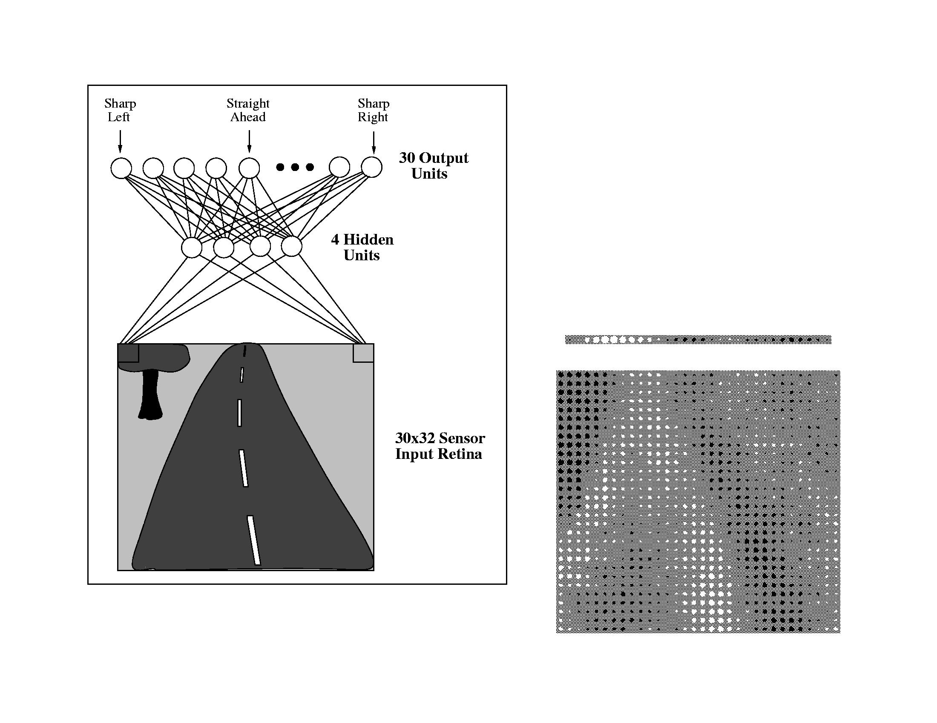
Neural Networks

Slide 8
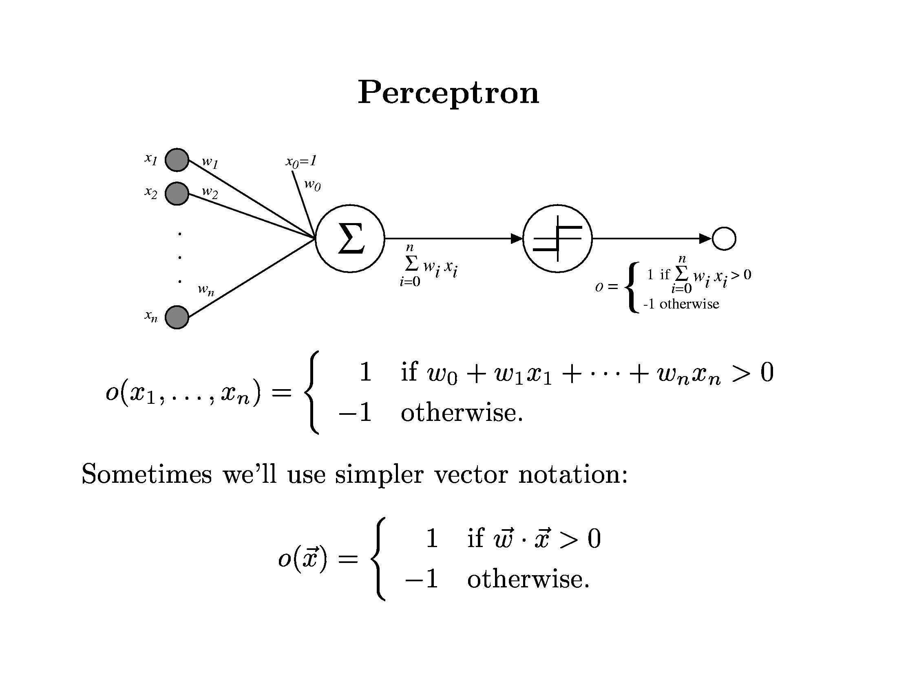
Neural Networks

Slide 9
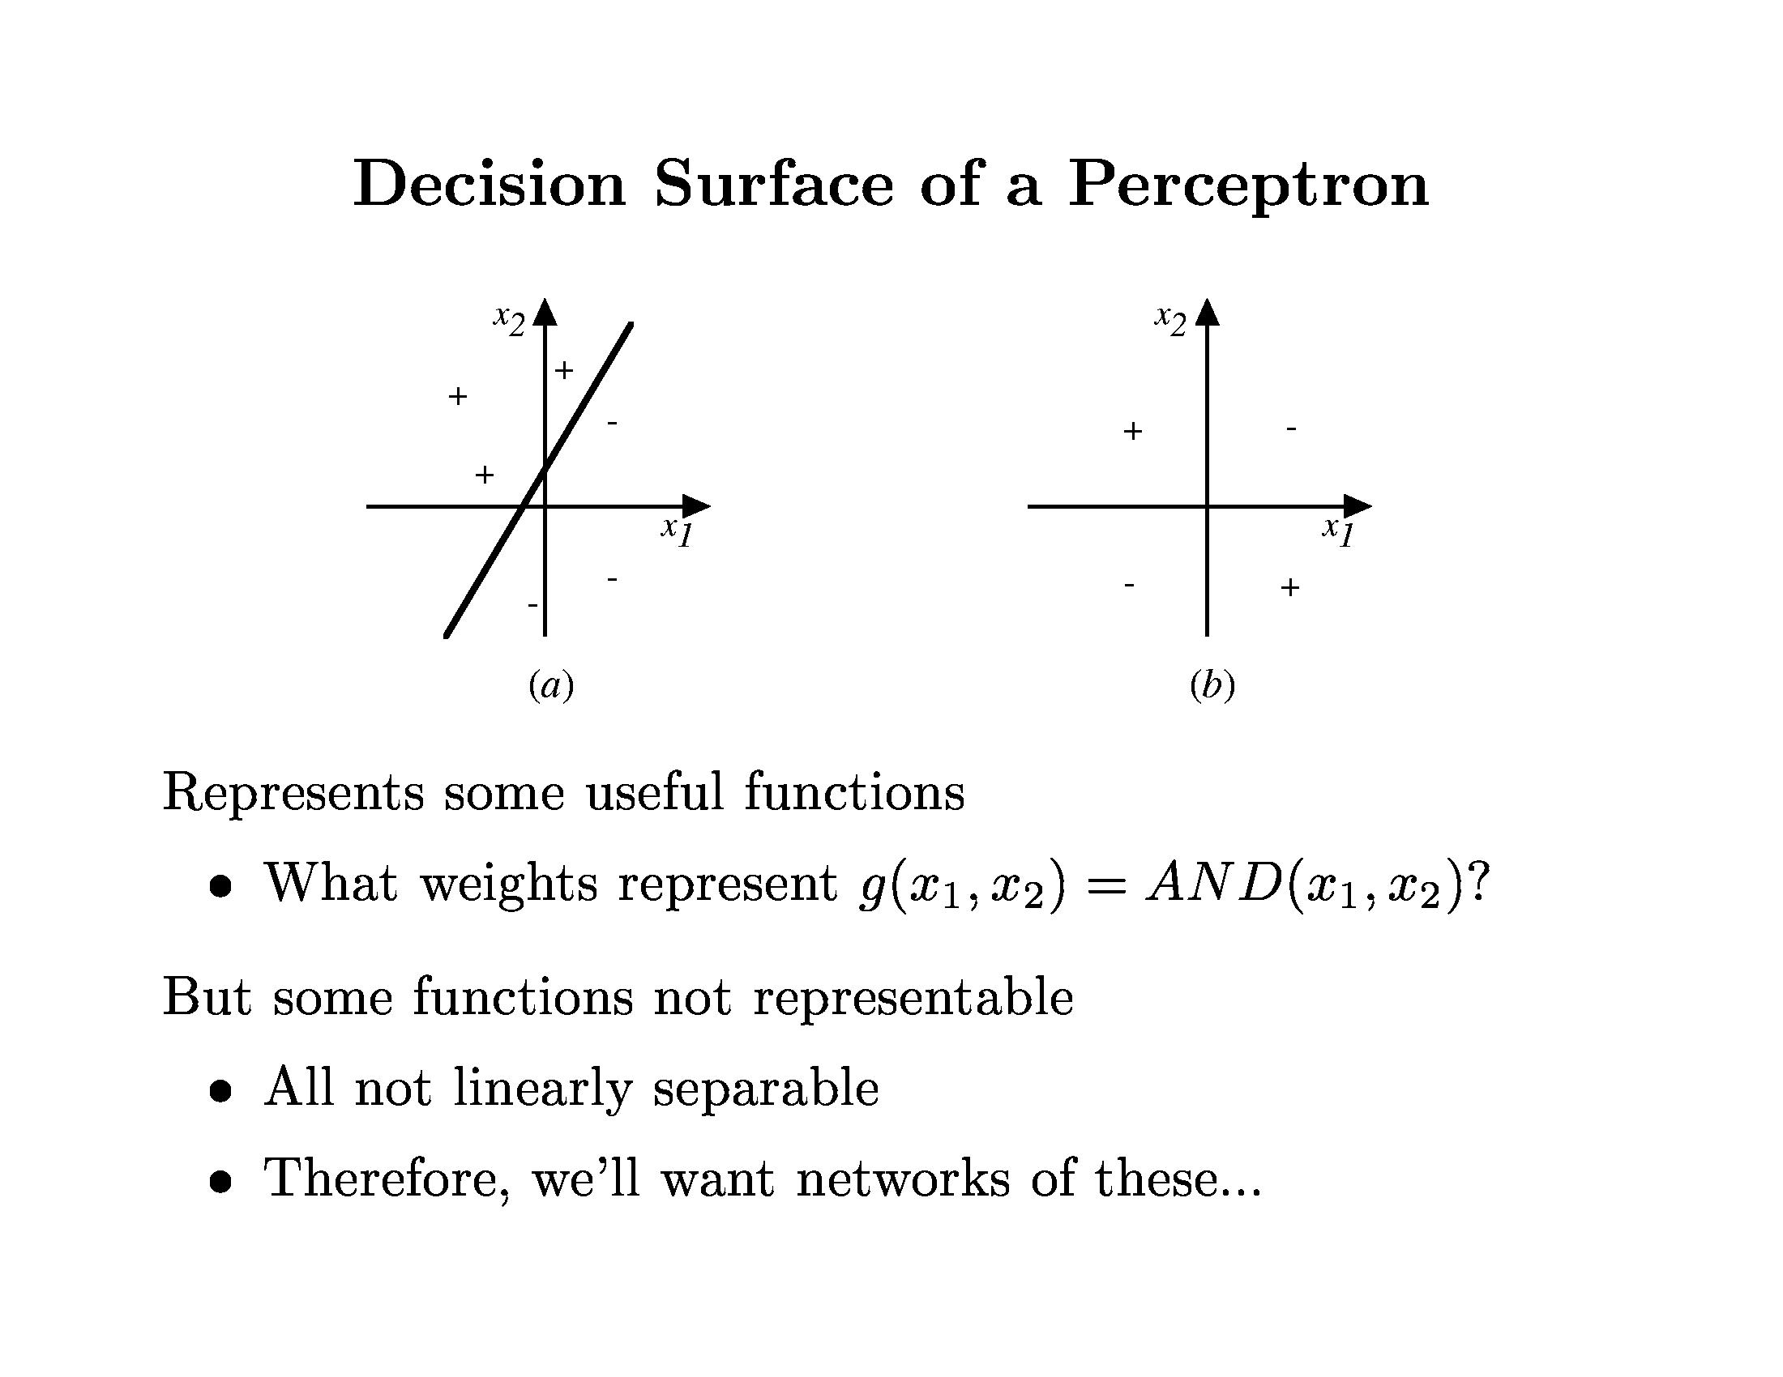
Neural Networks

Slide 10
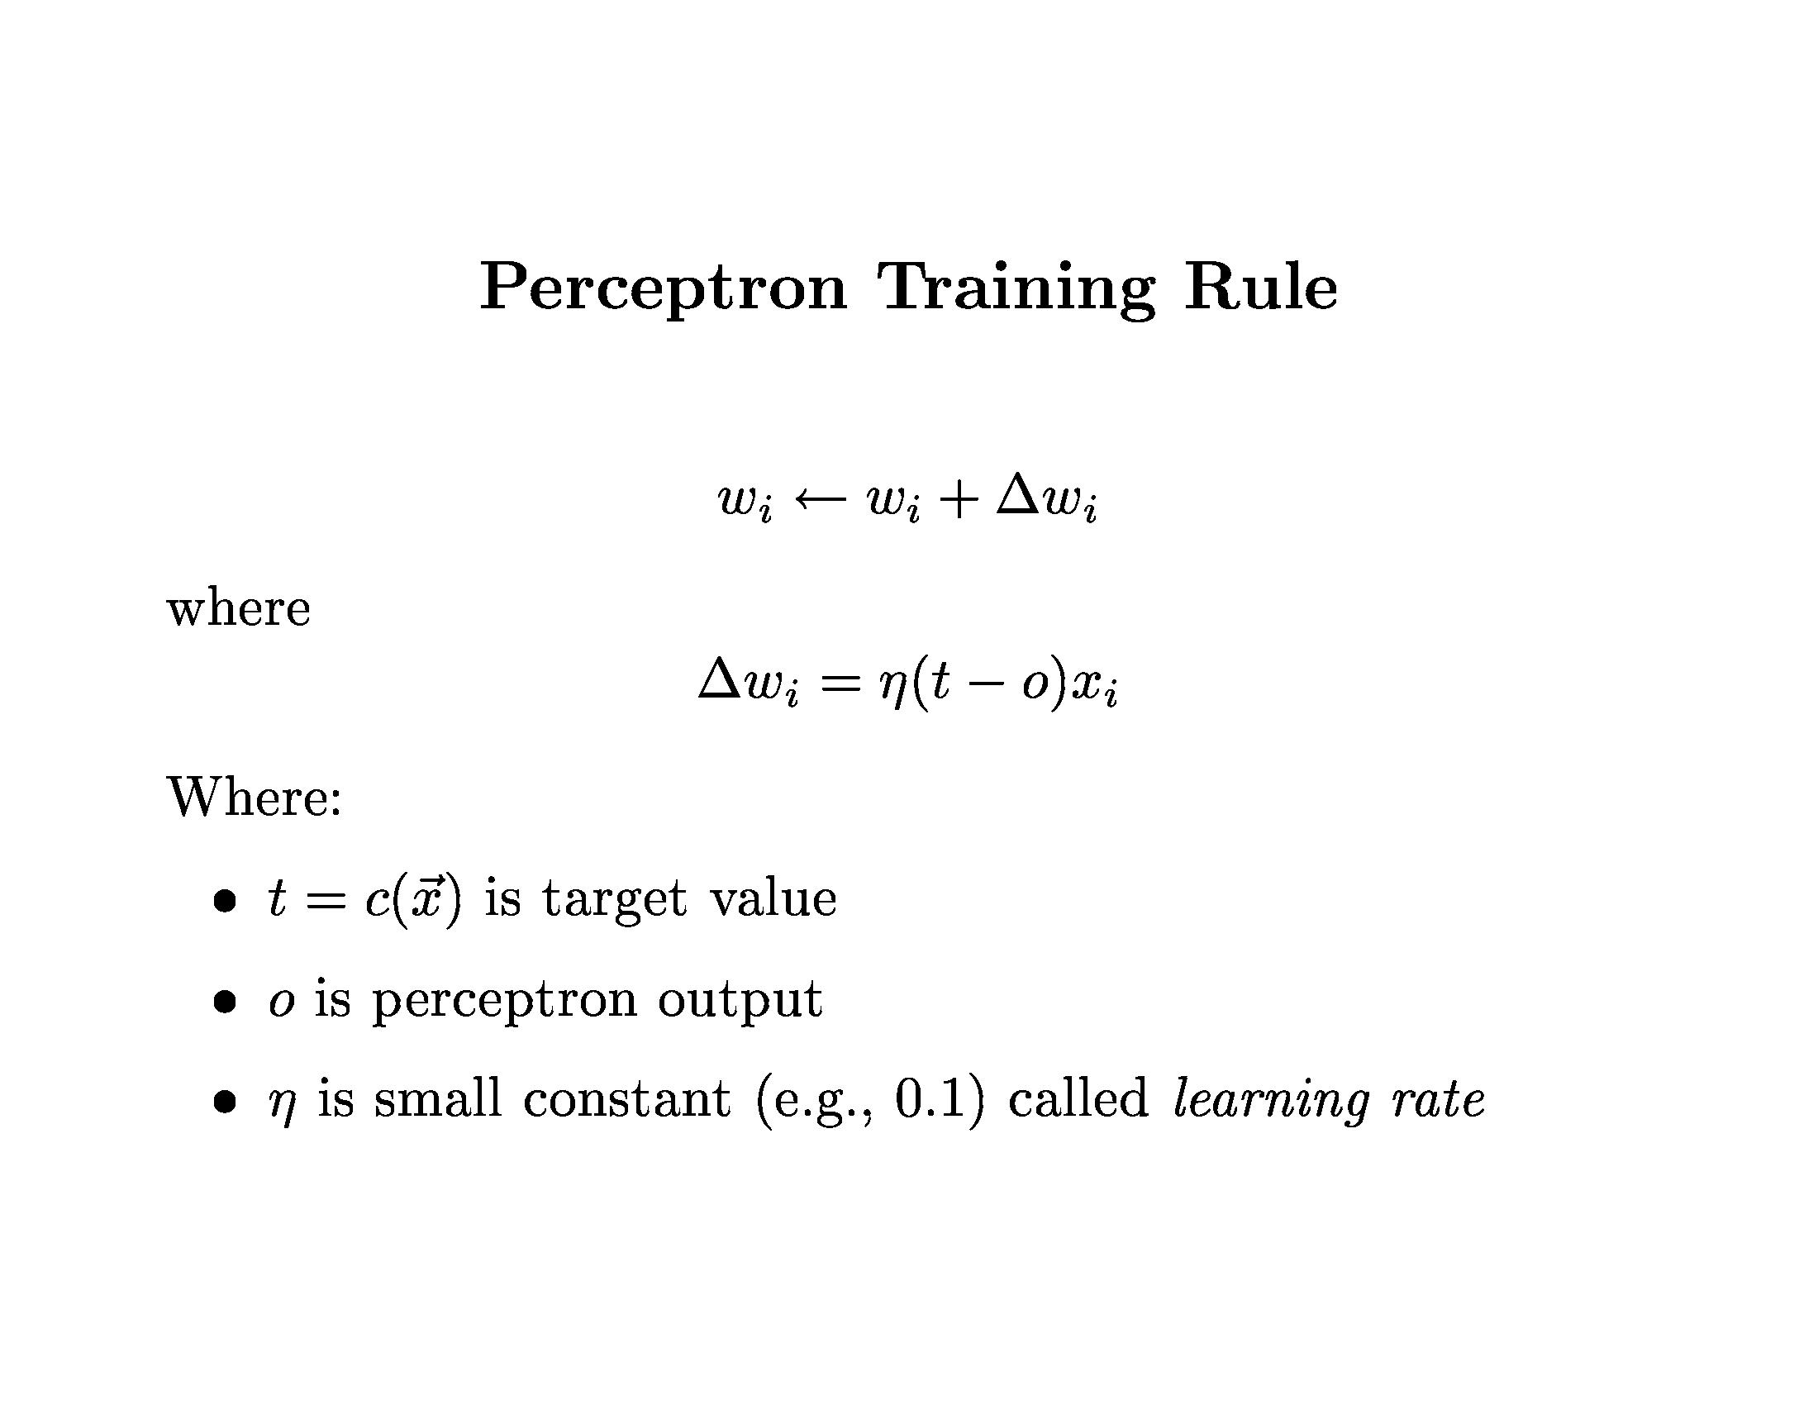
Neural Networks

Slide 11
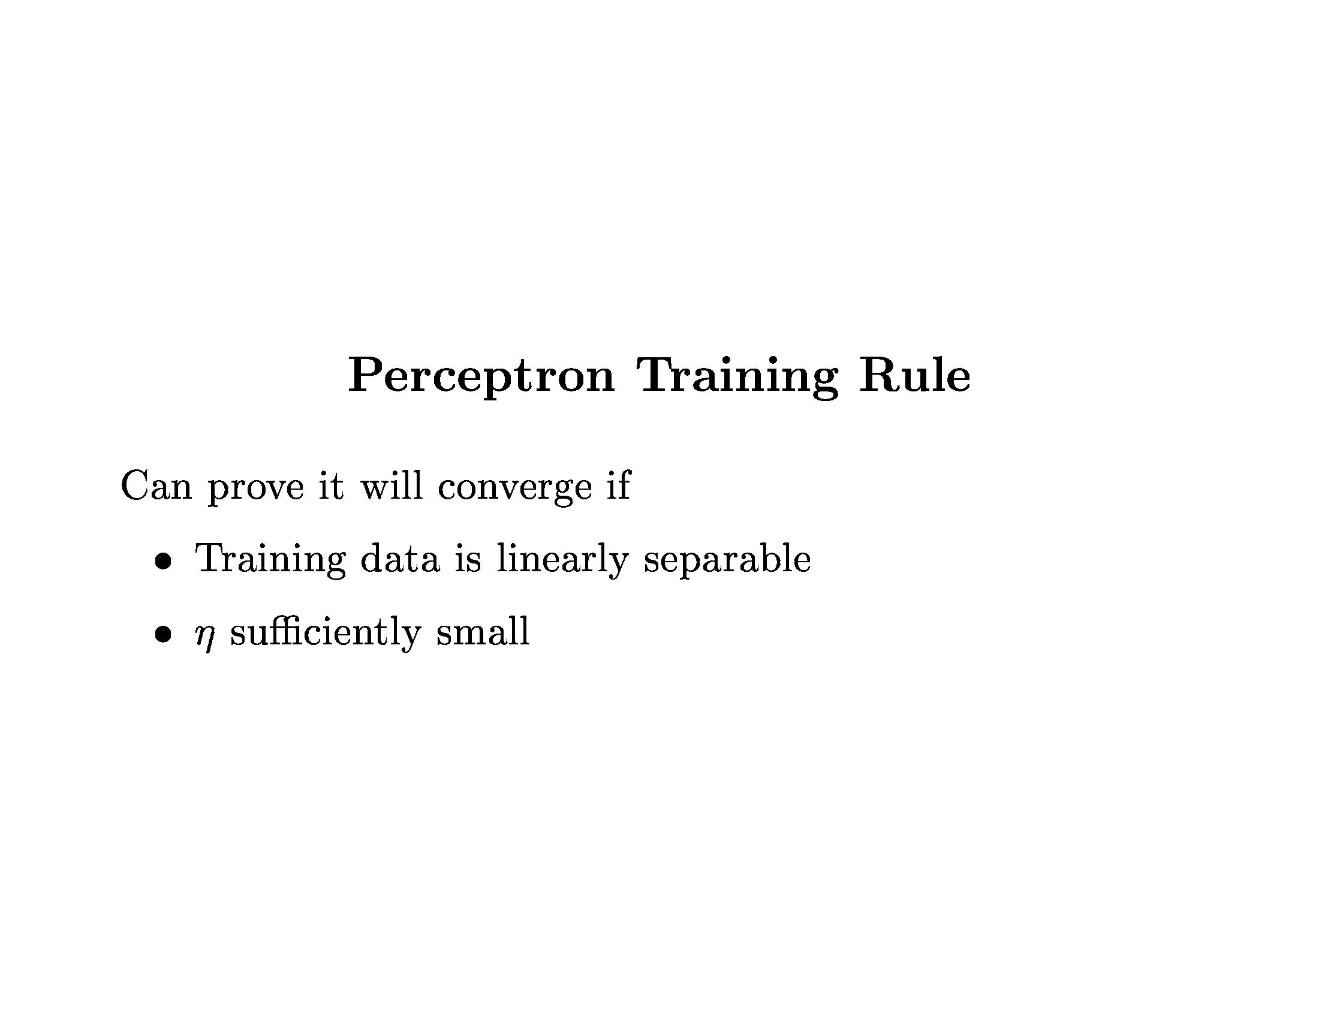
Neural Networks

Slide 12
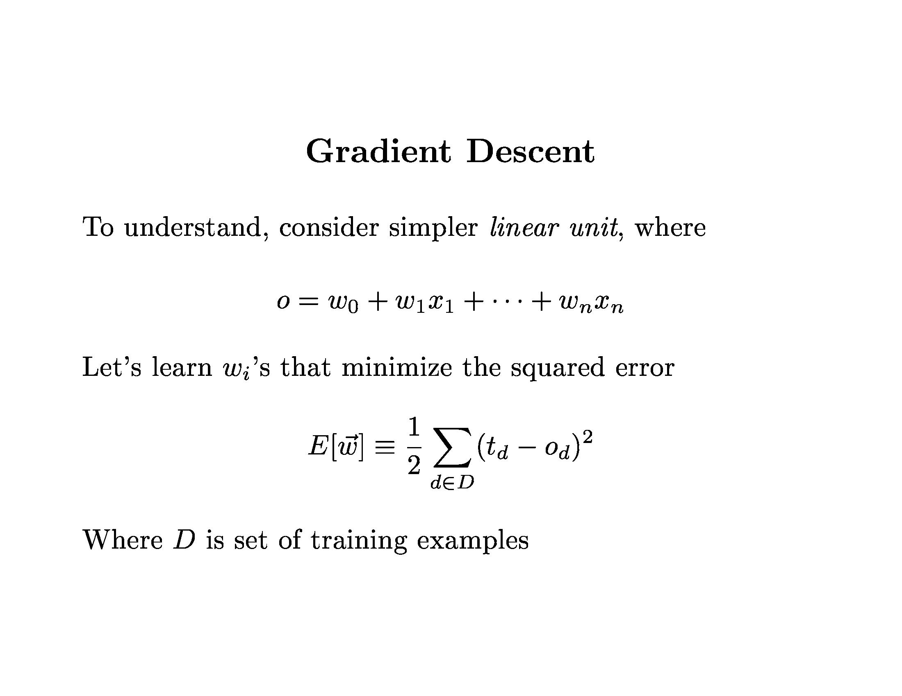
Neural Networks

Slide 13
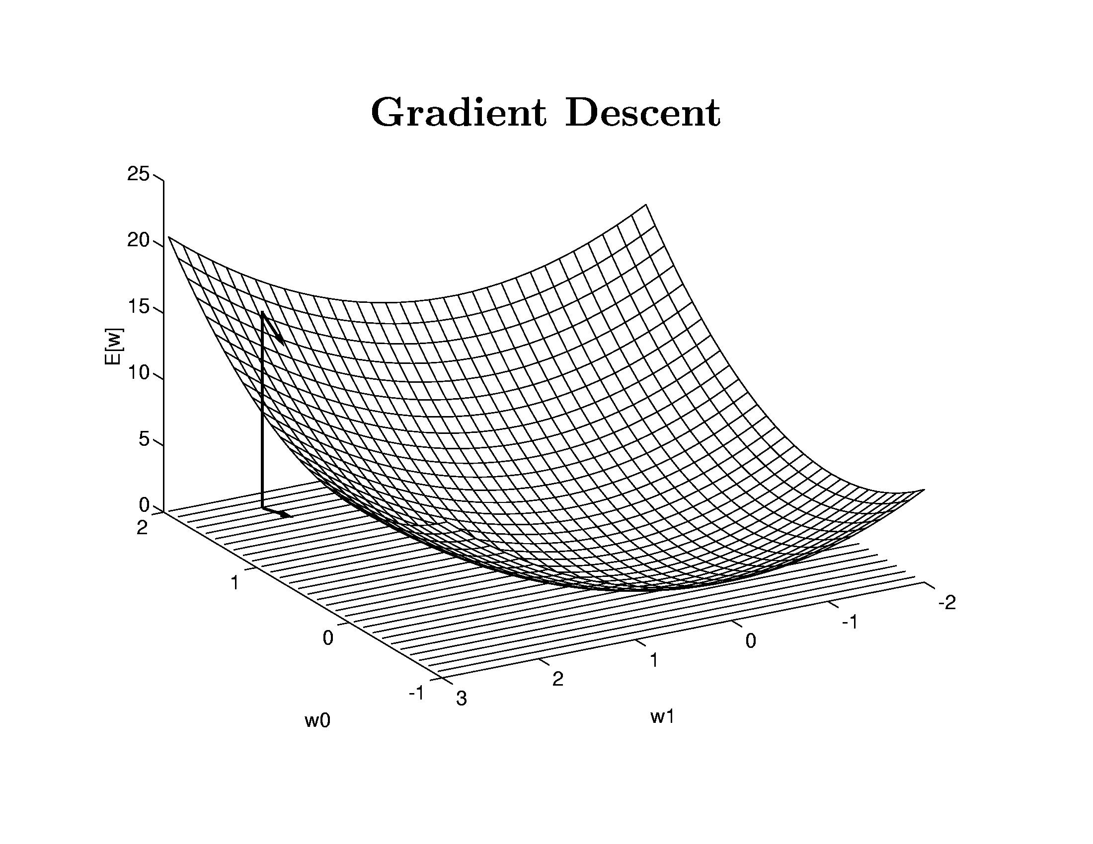
Neural Networks

Slide 14
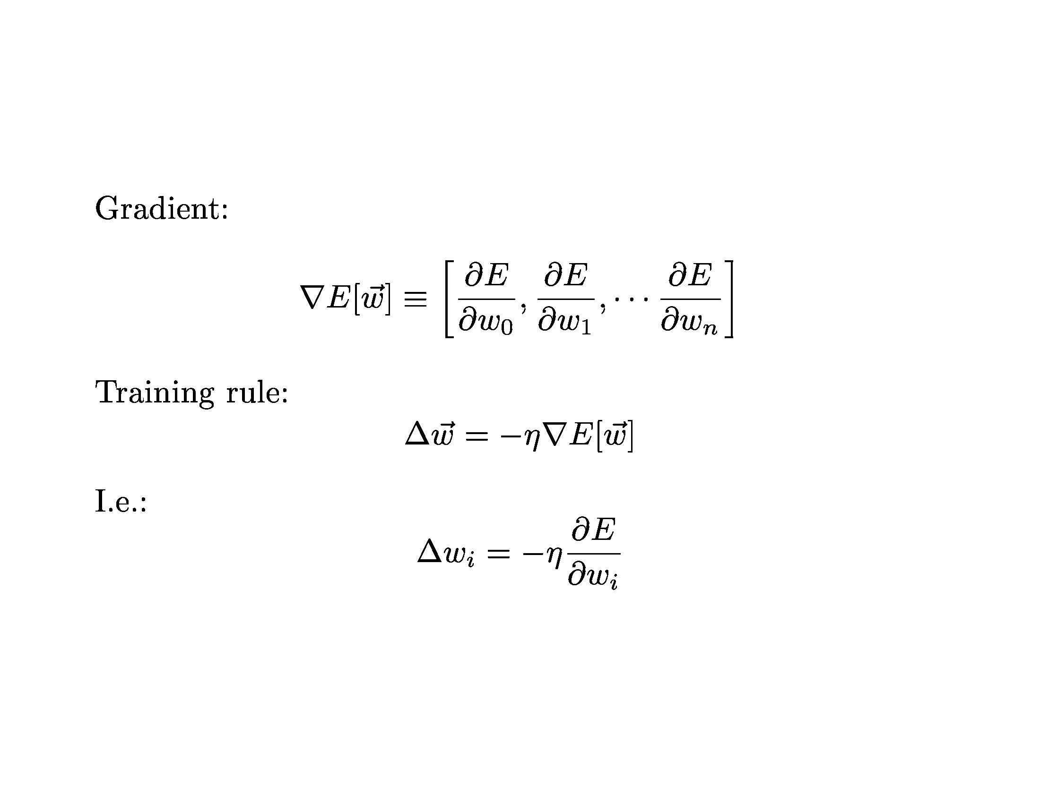
Neural Networks

Slide 15
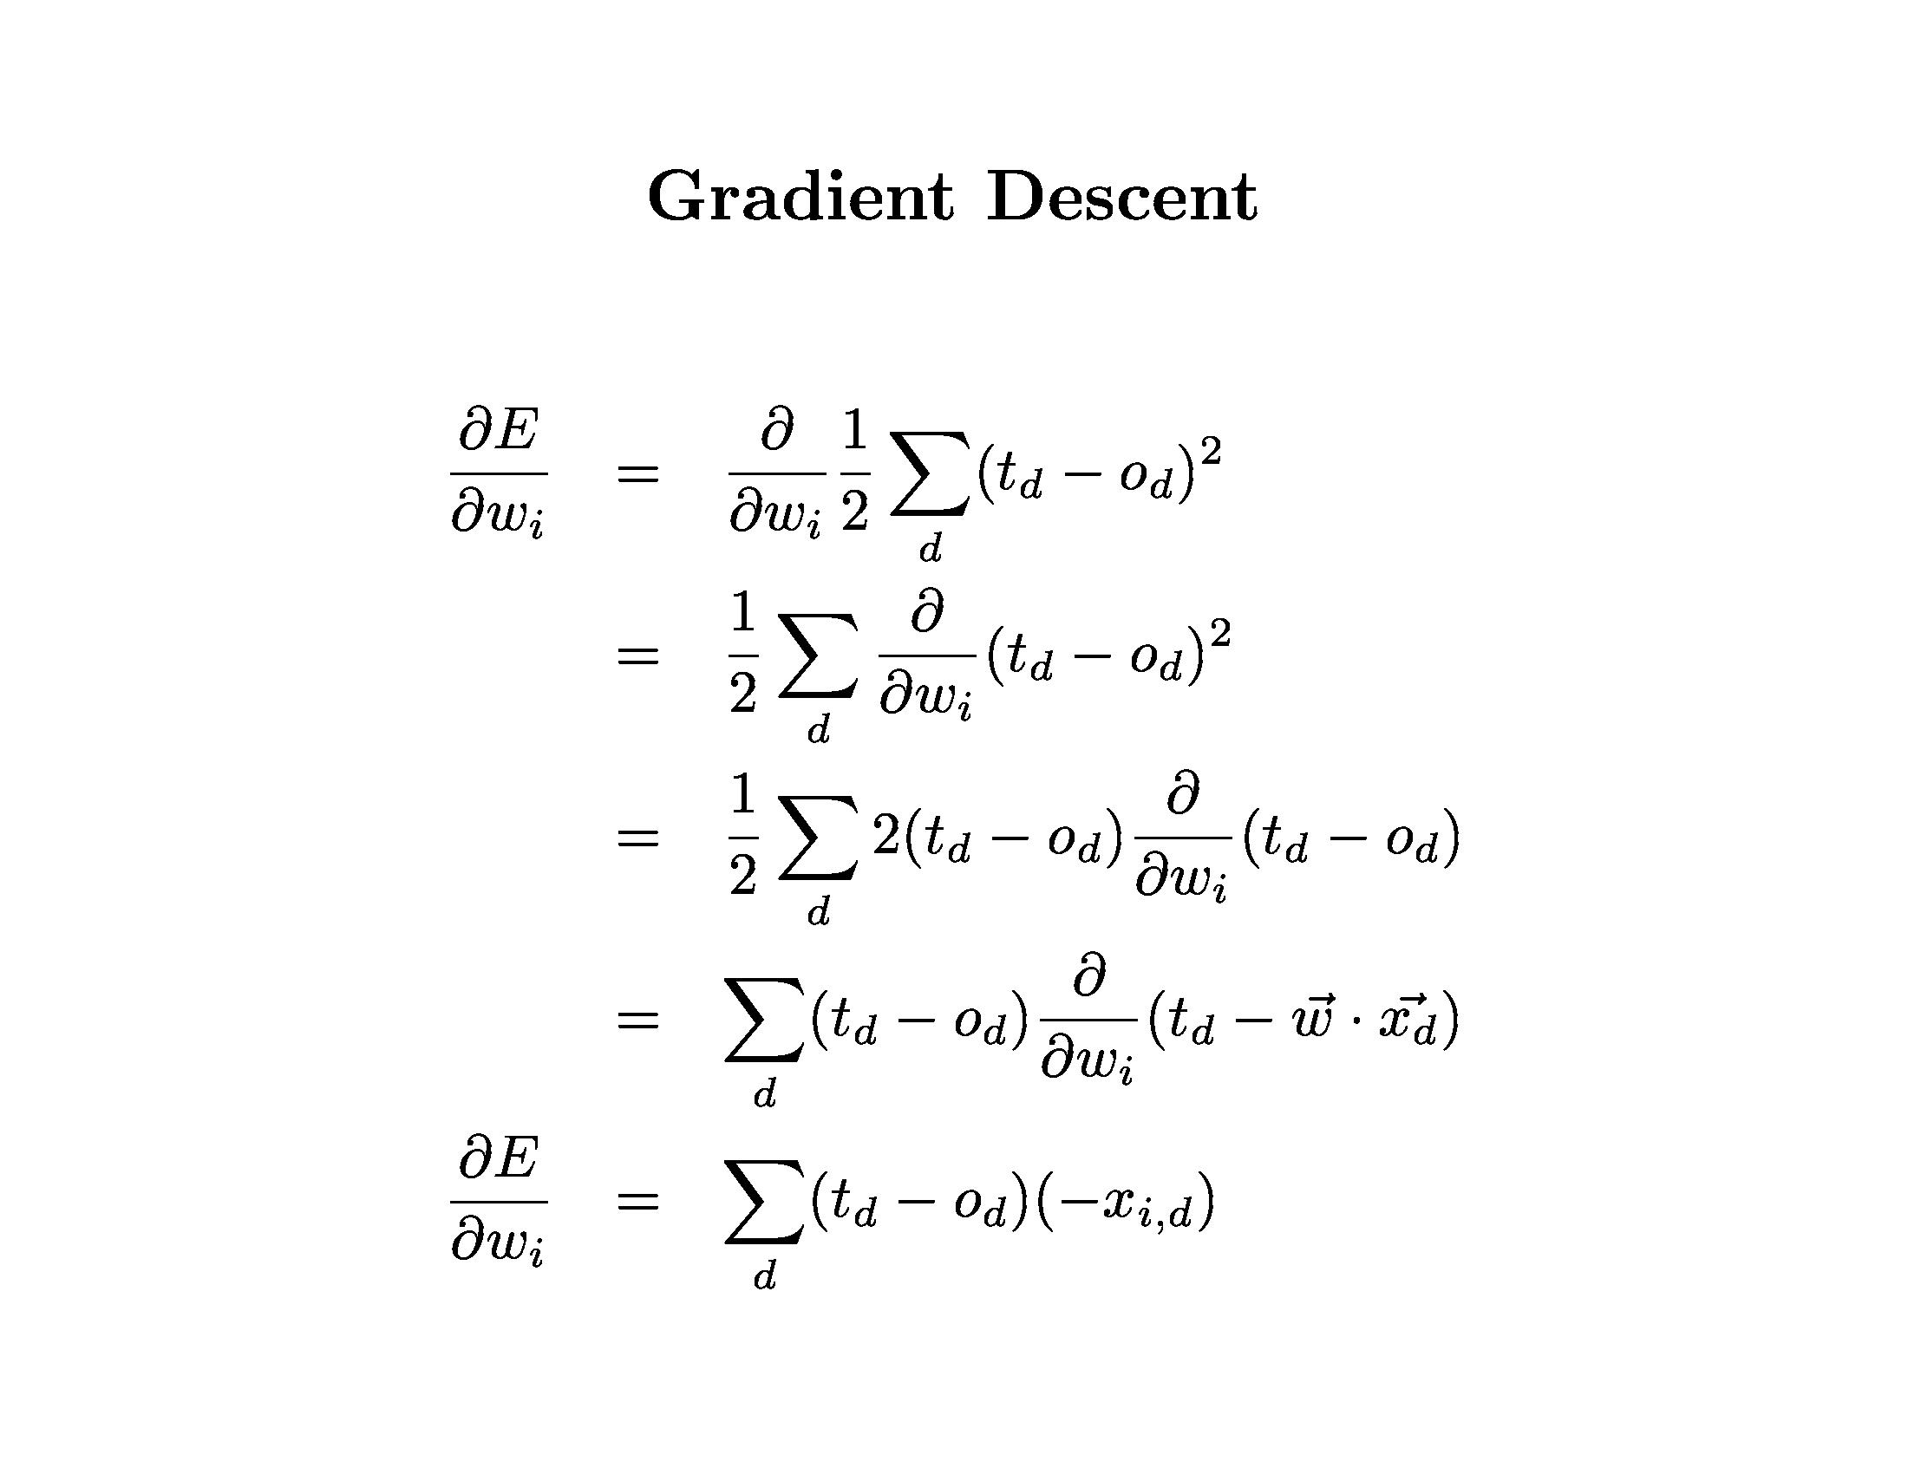
Neural Networks

Slide 16
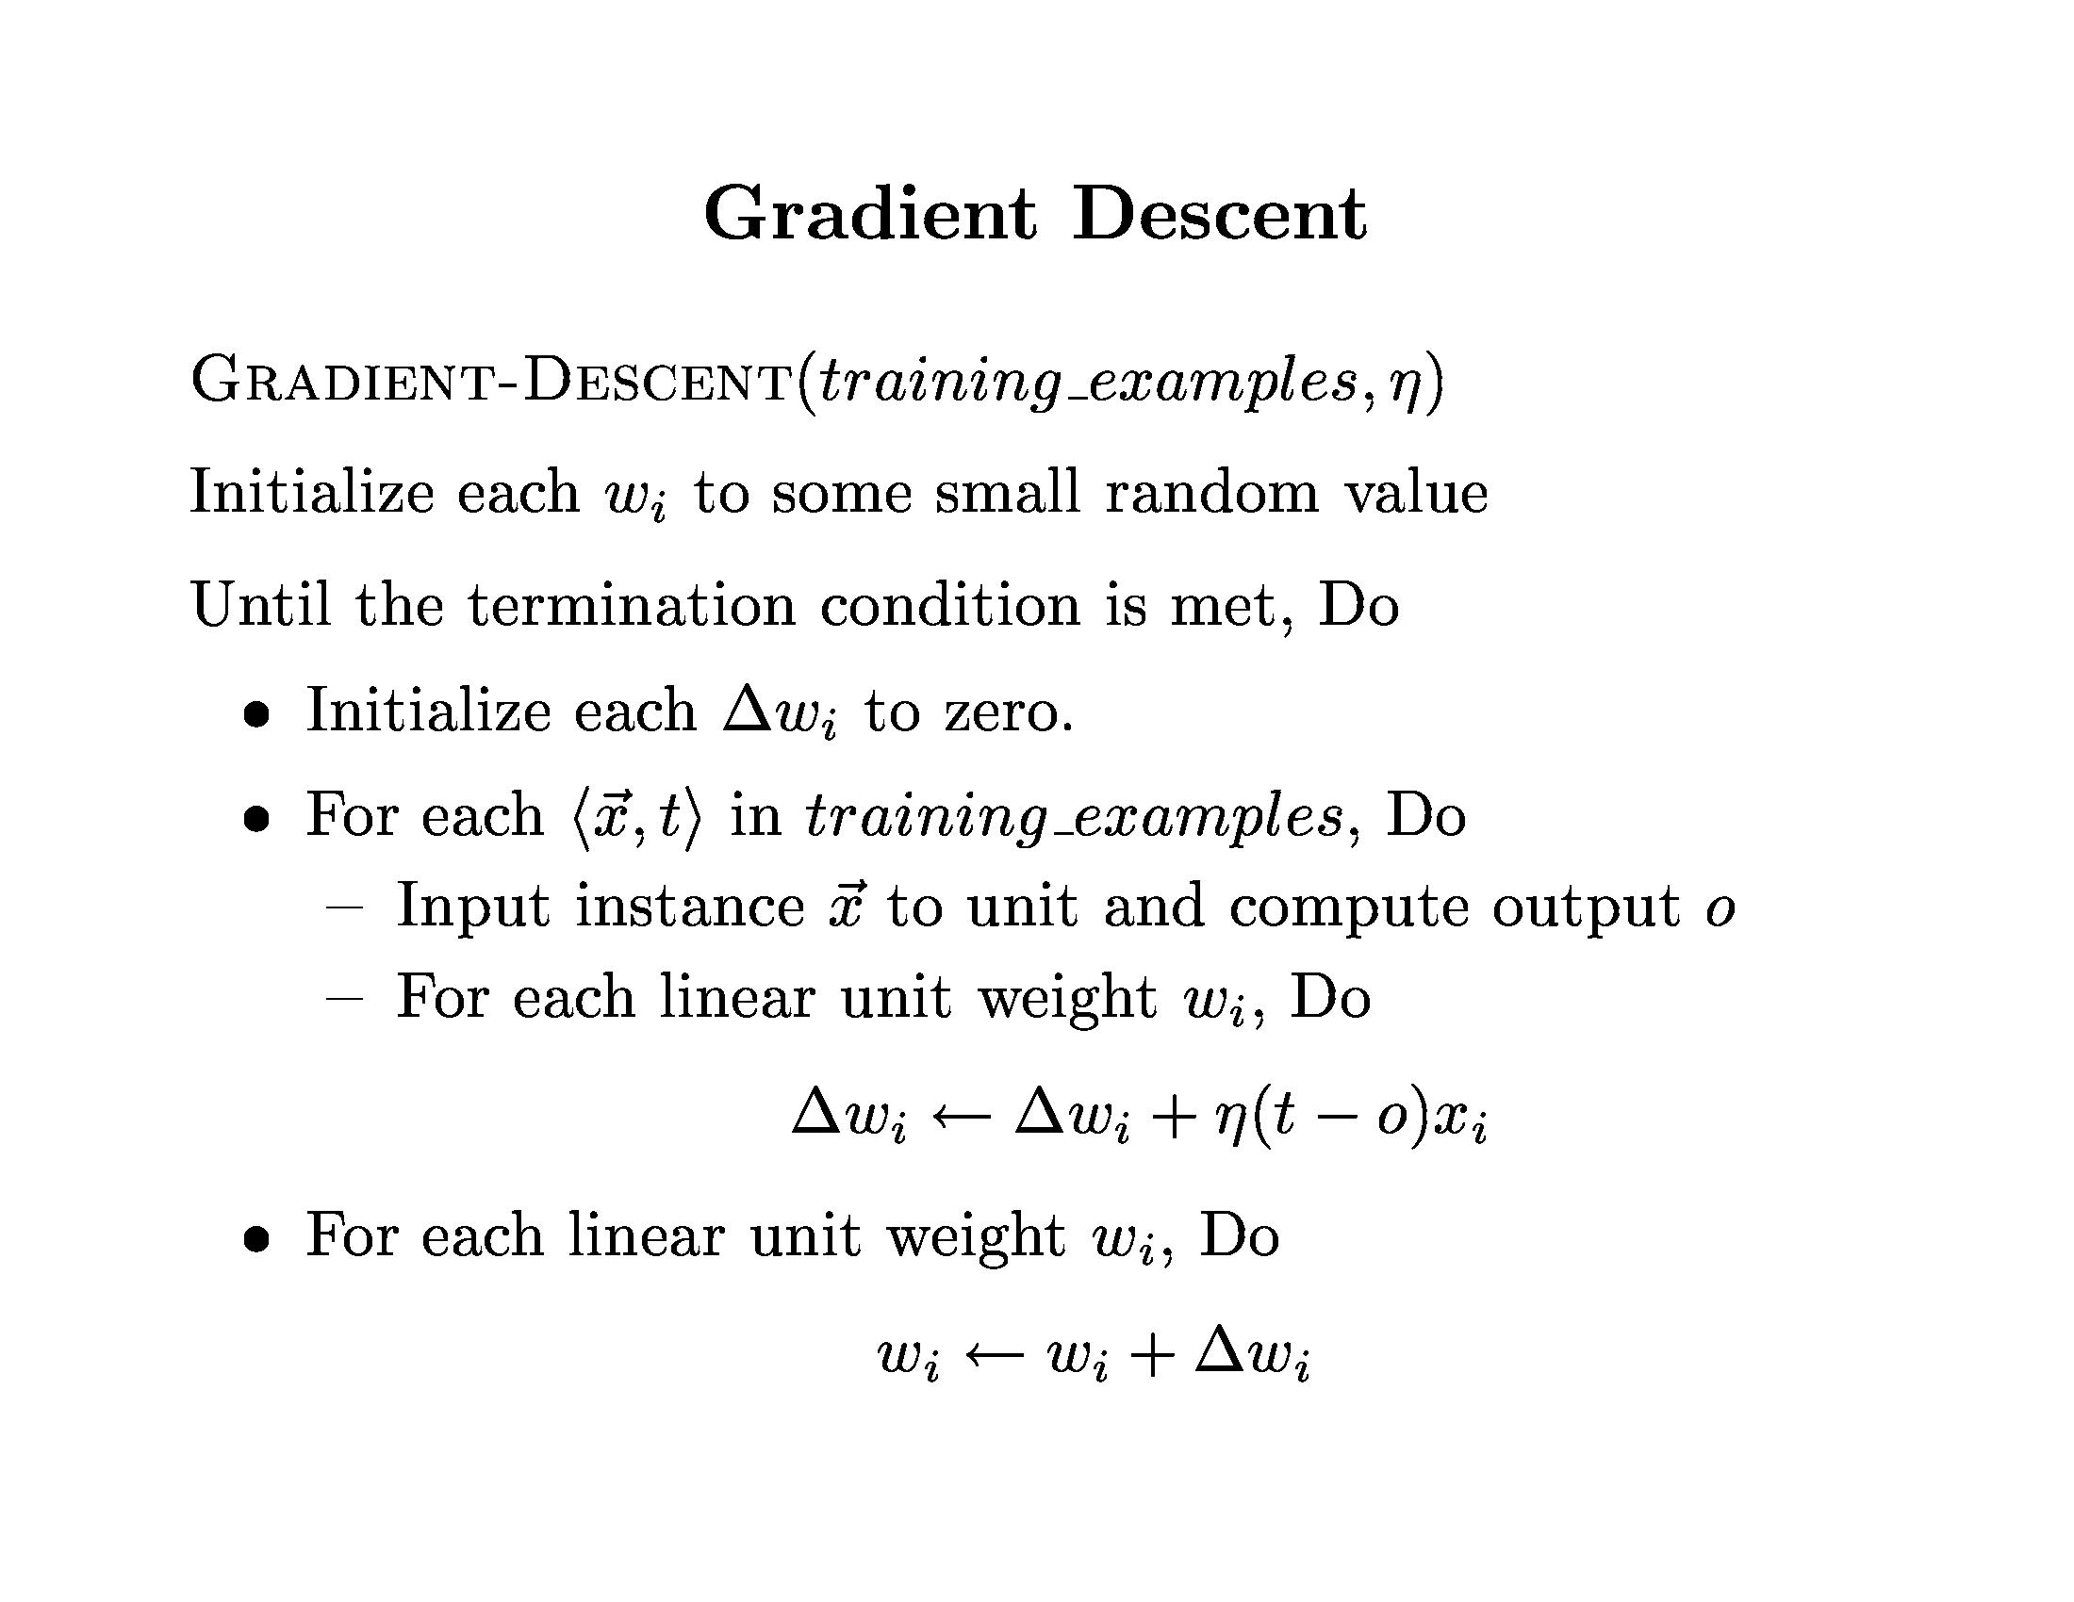
Neural Networks

Slide 17
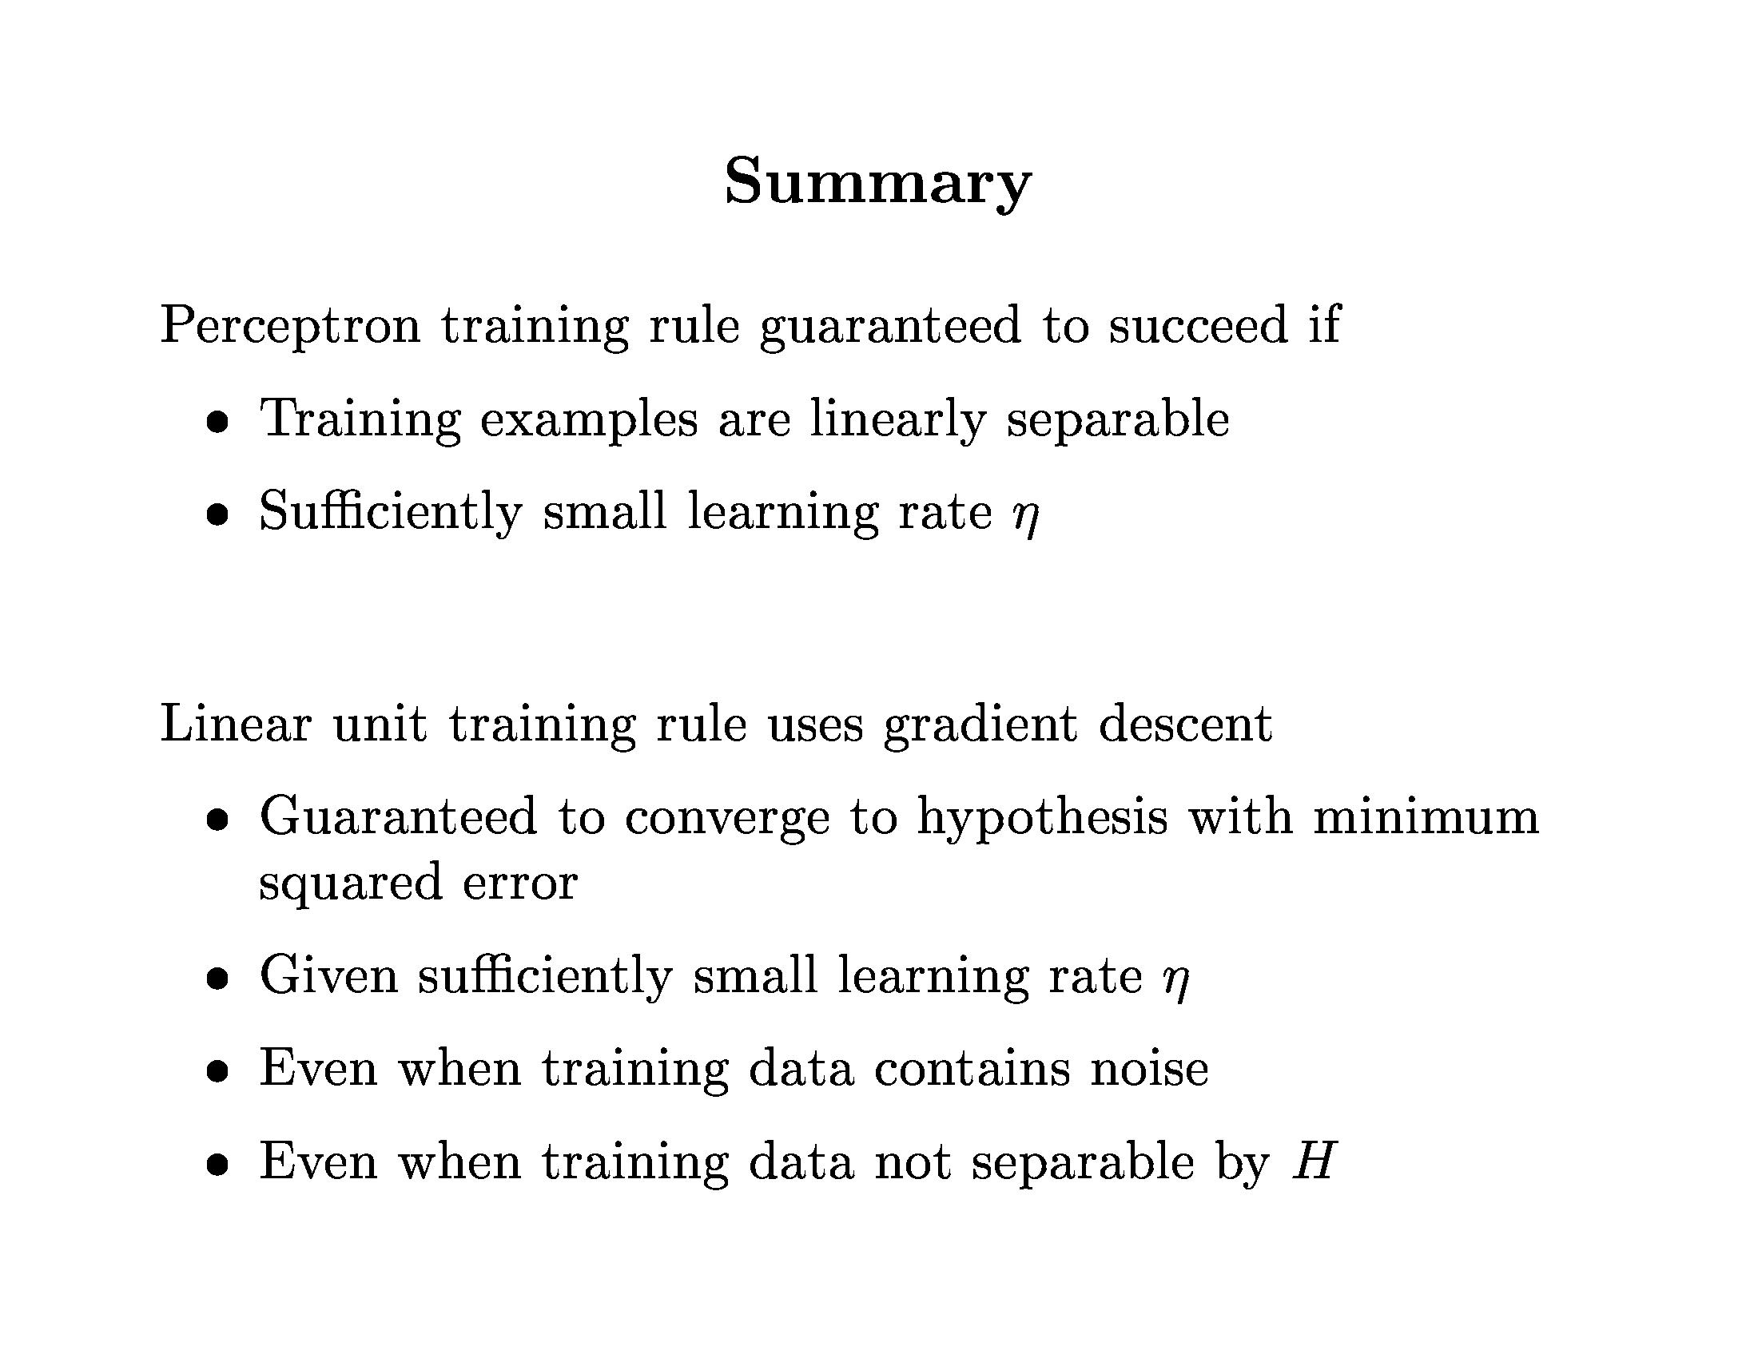
Neural Networks

Slide 18
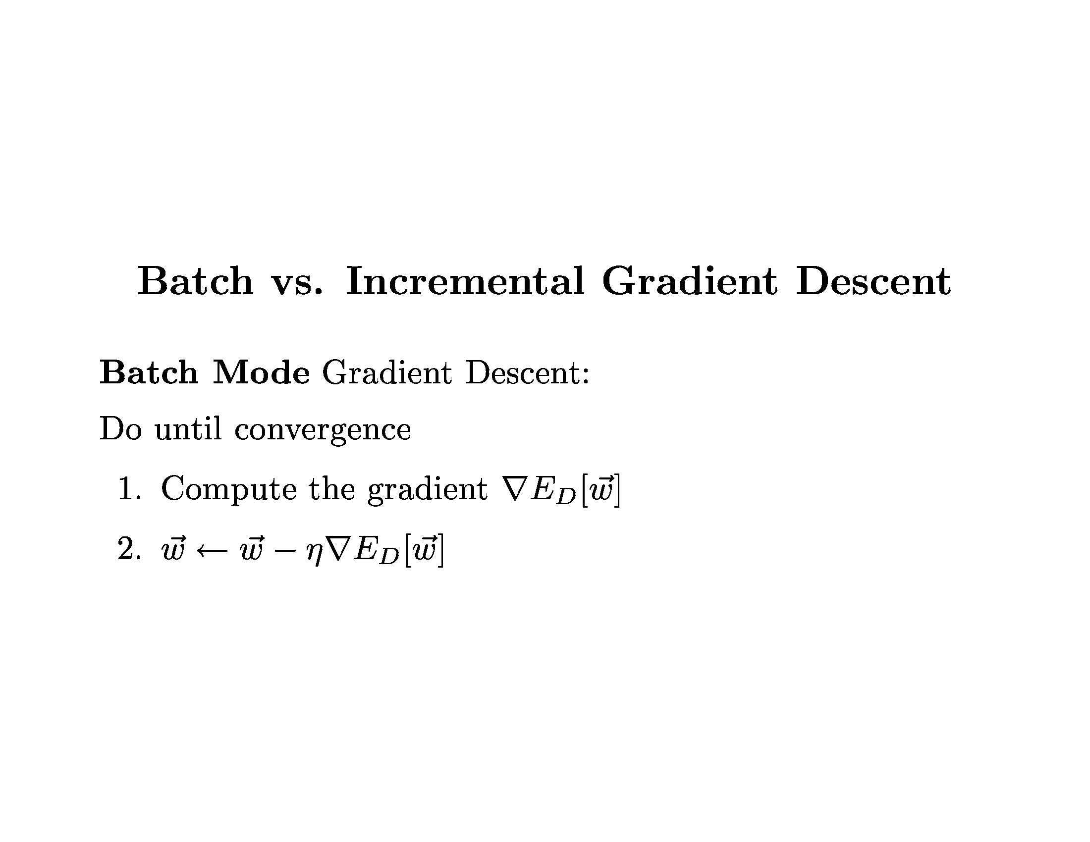
Neural Networks

Slide 19
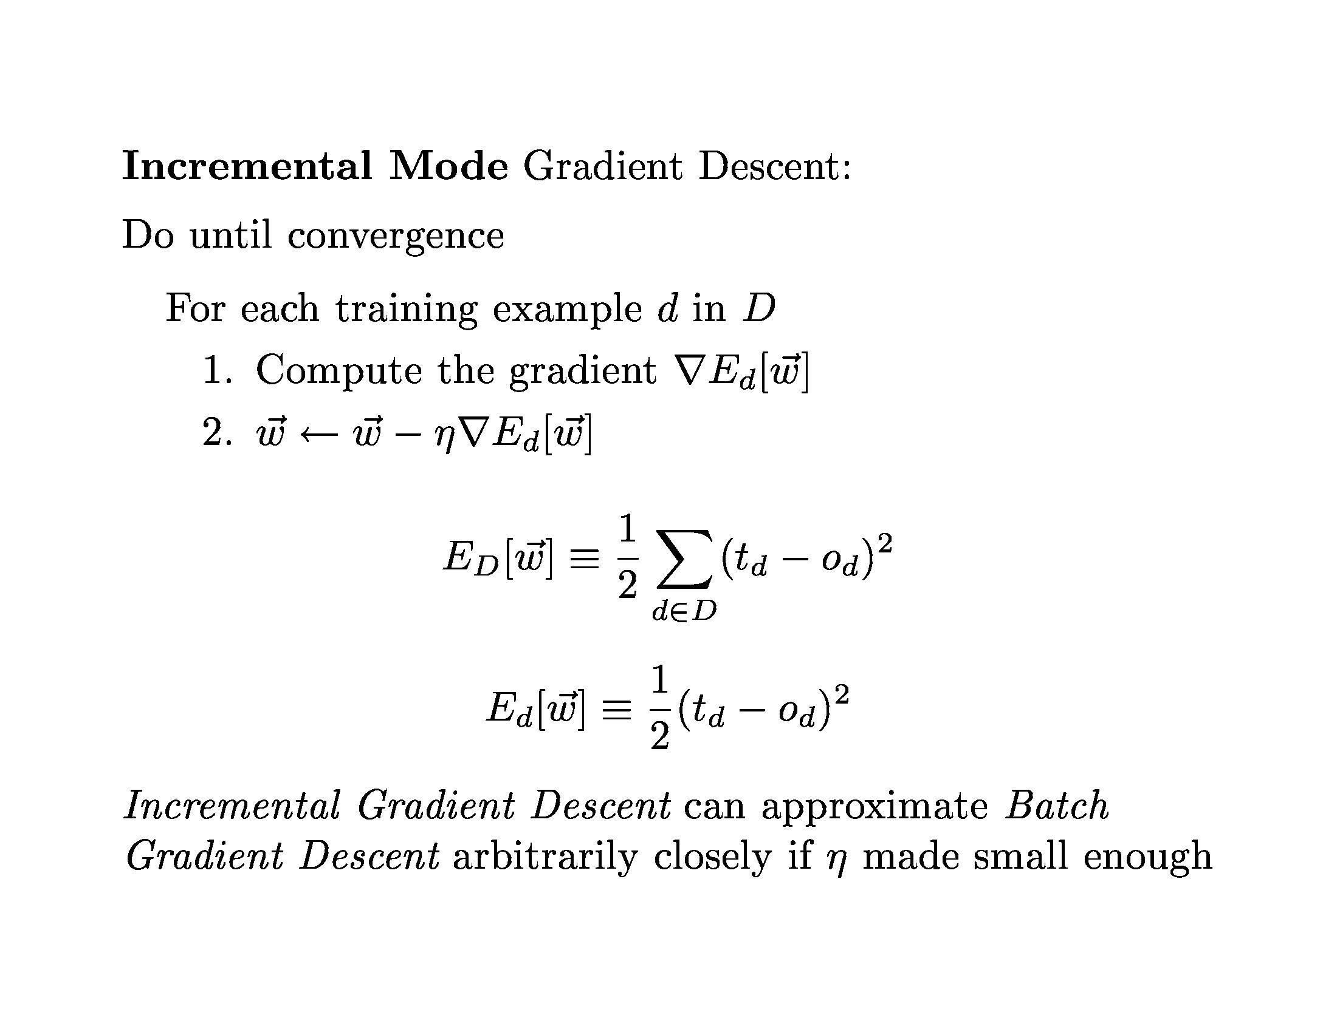
Neural Networks

Slide 20
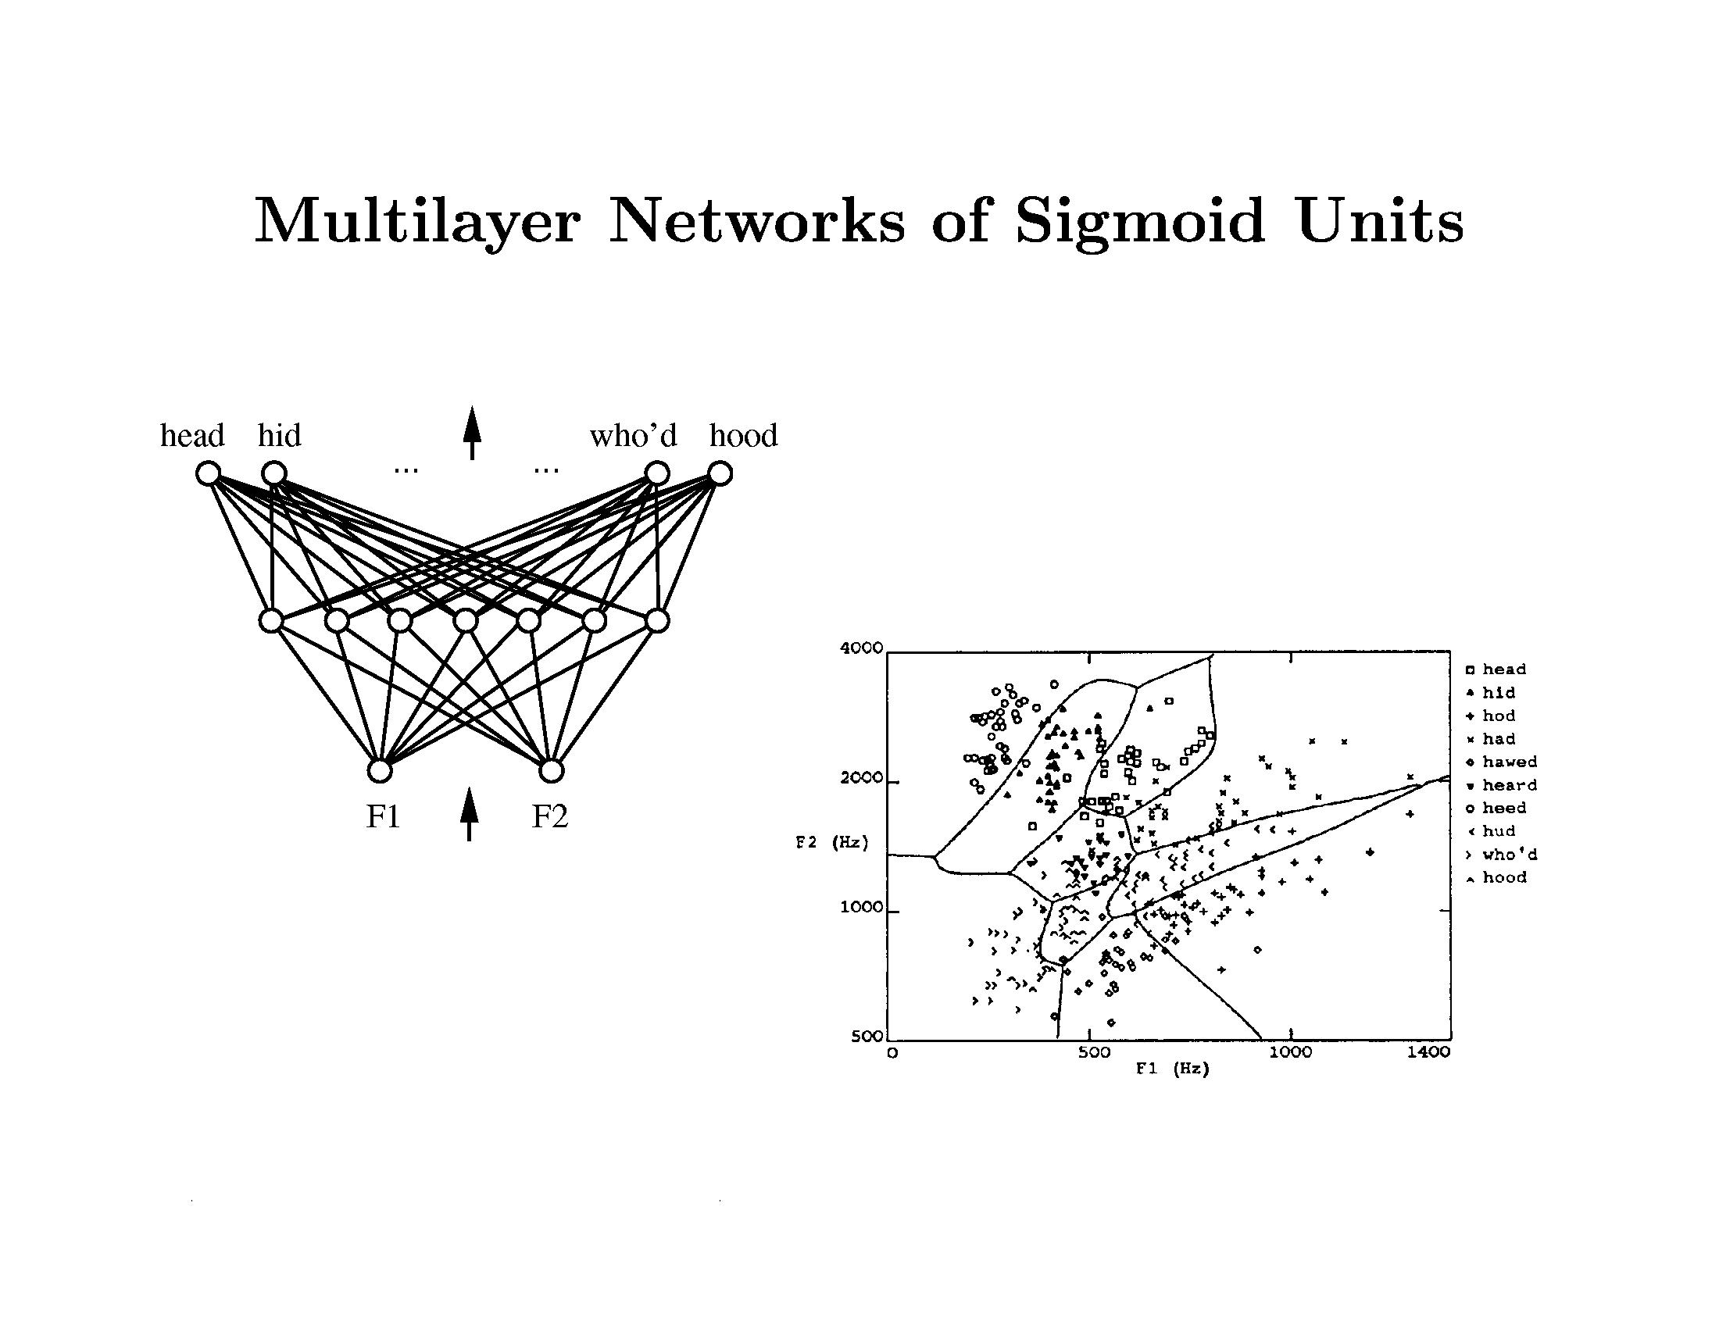
Neural Networks

Slide 21
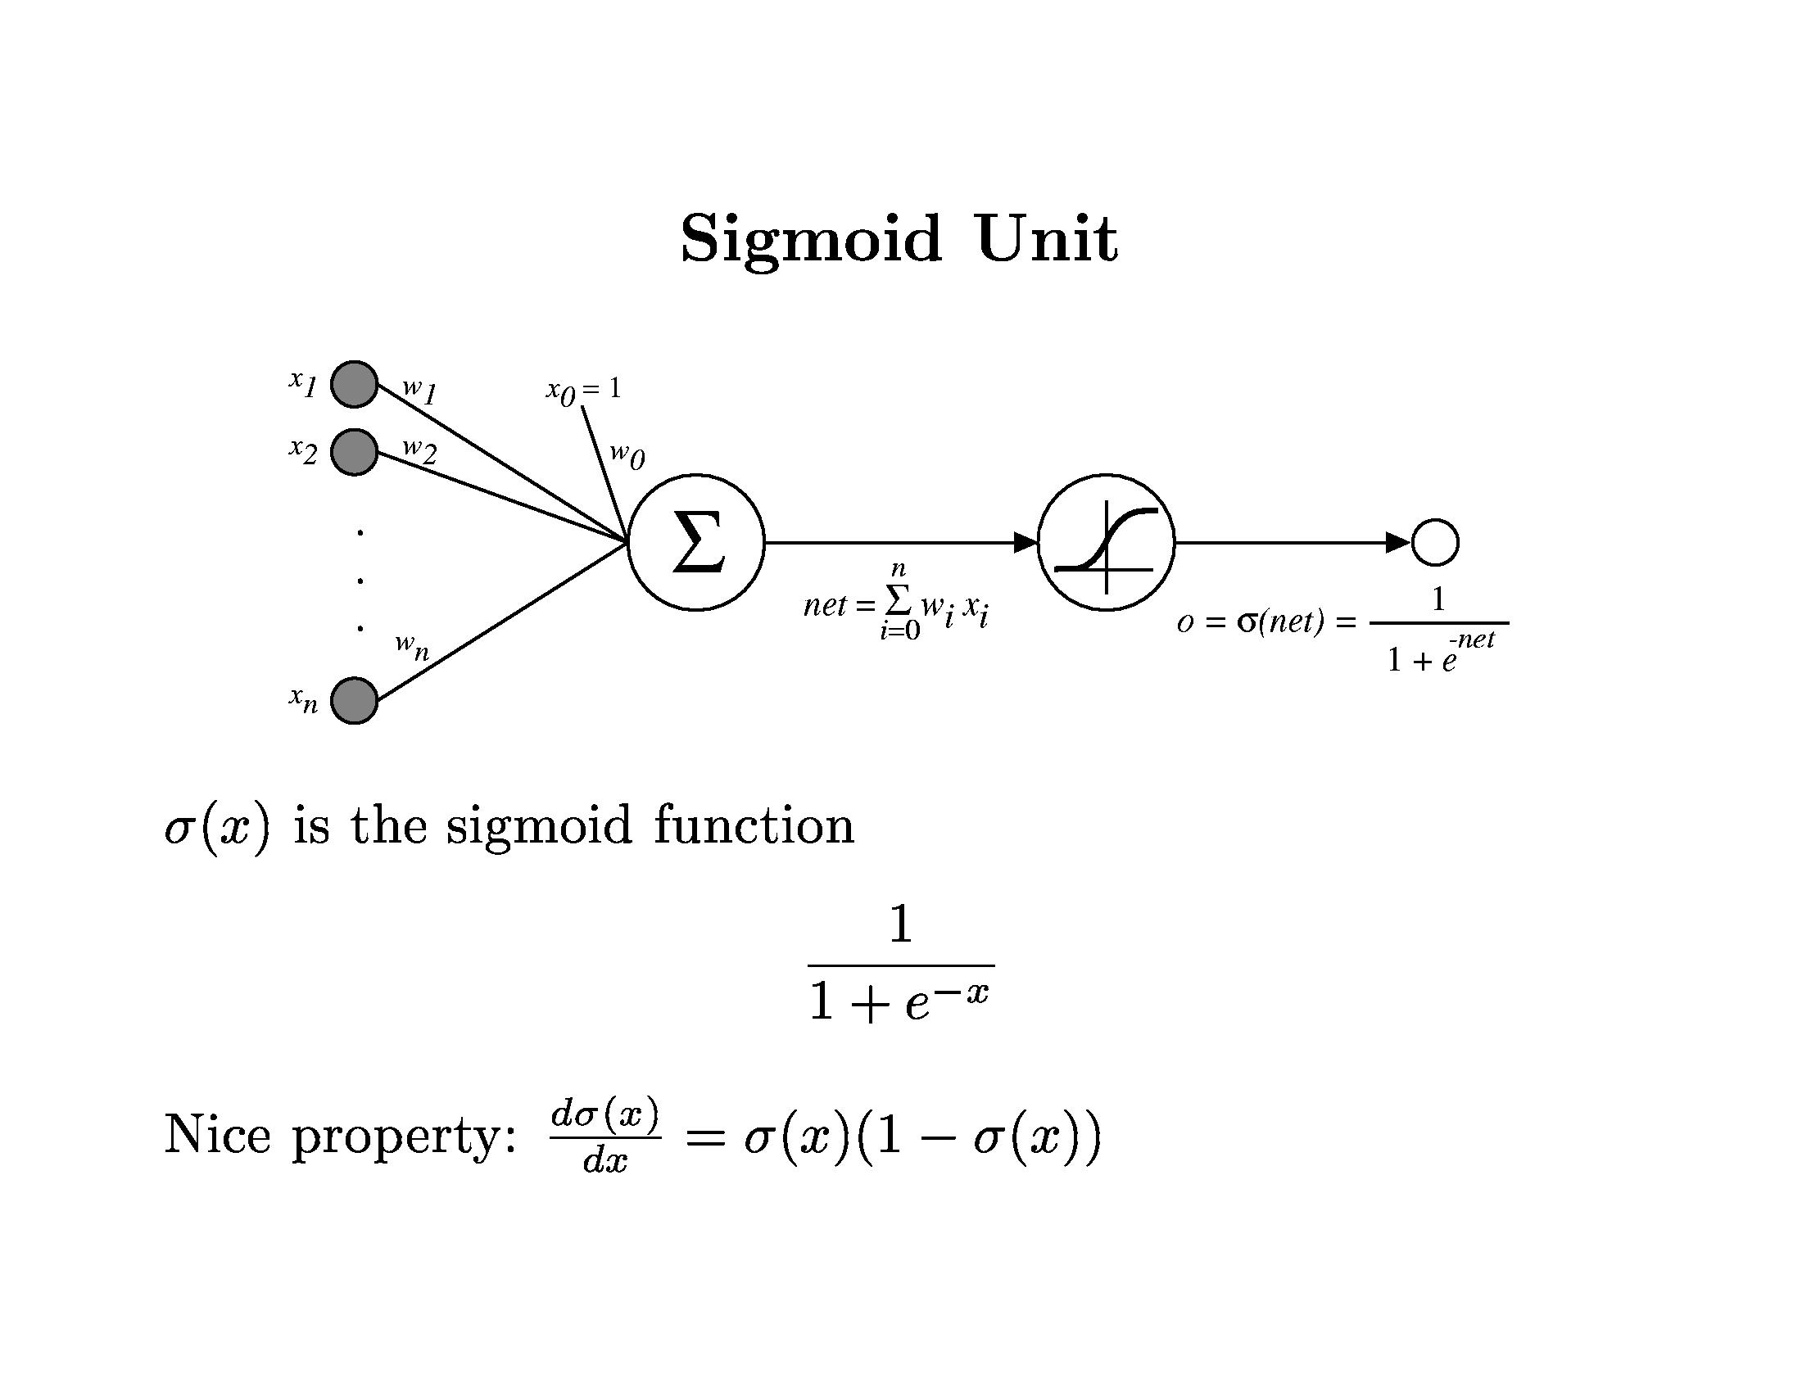
Neural Networks

Slide 22
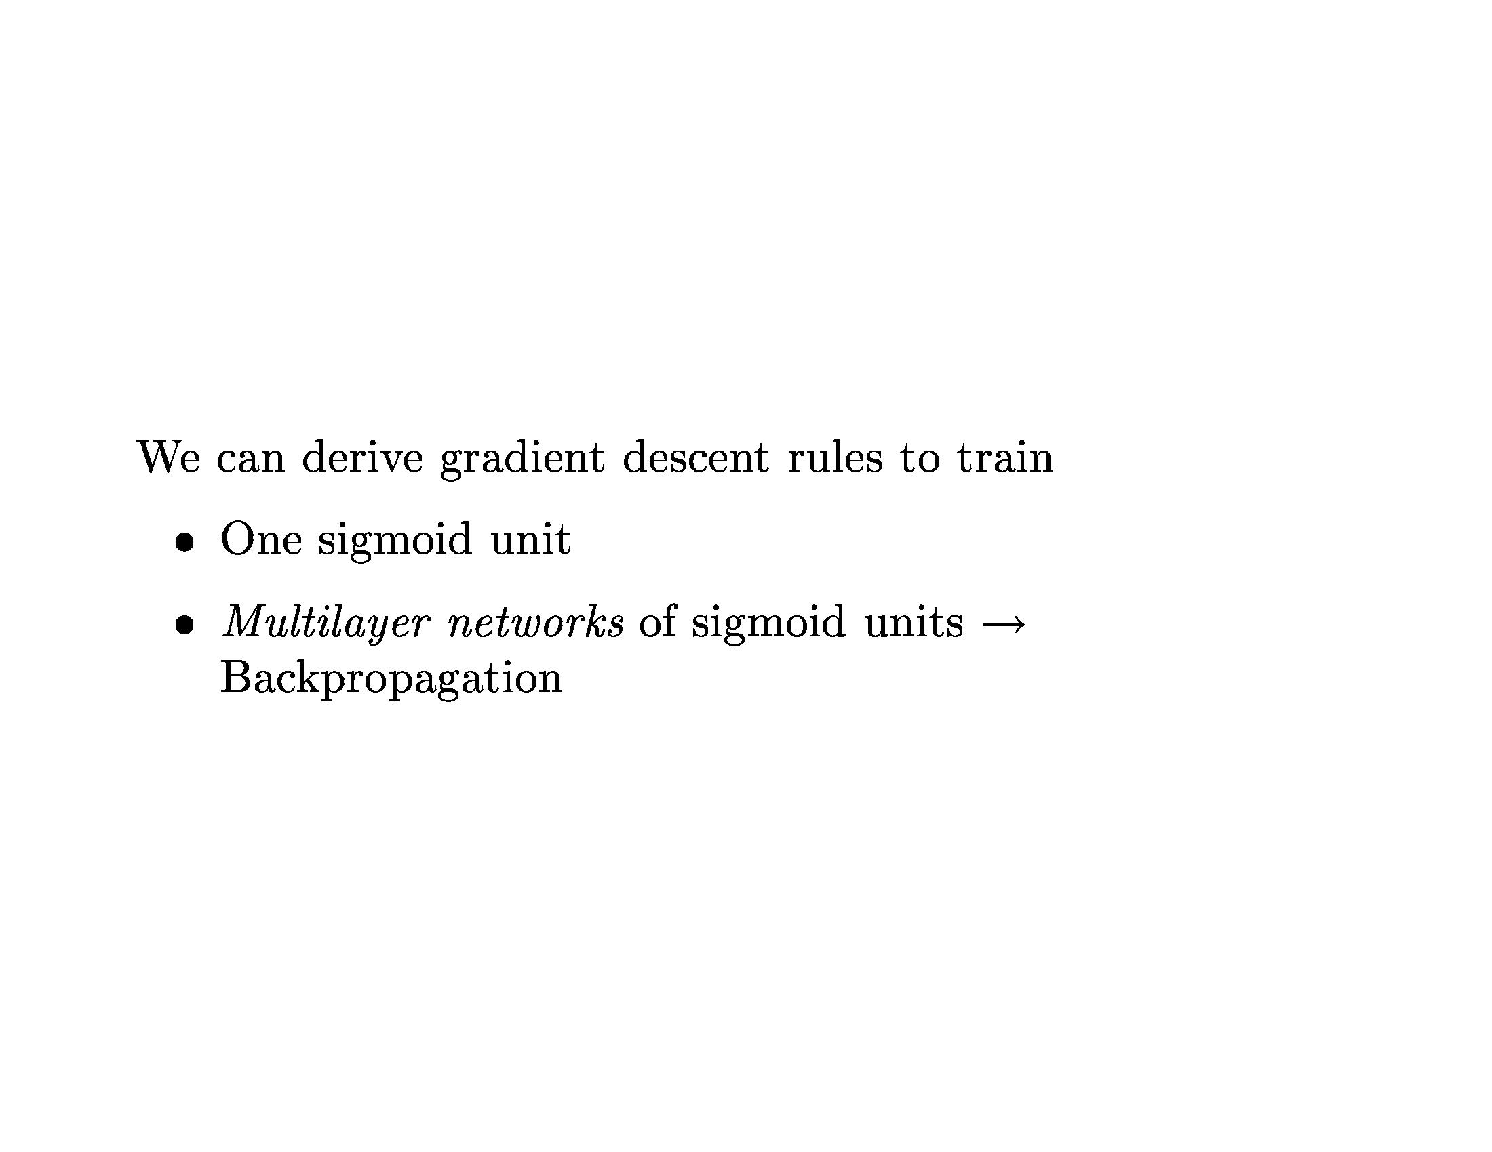
Neural Networks

Slide 23
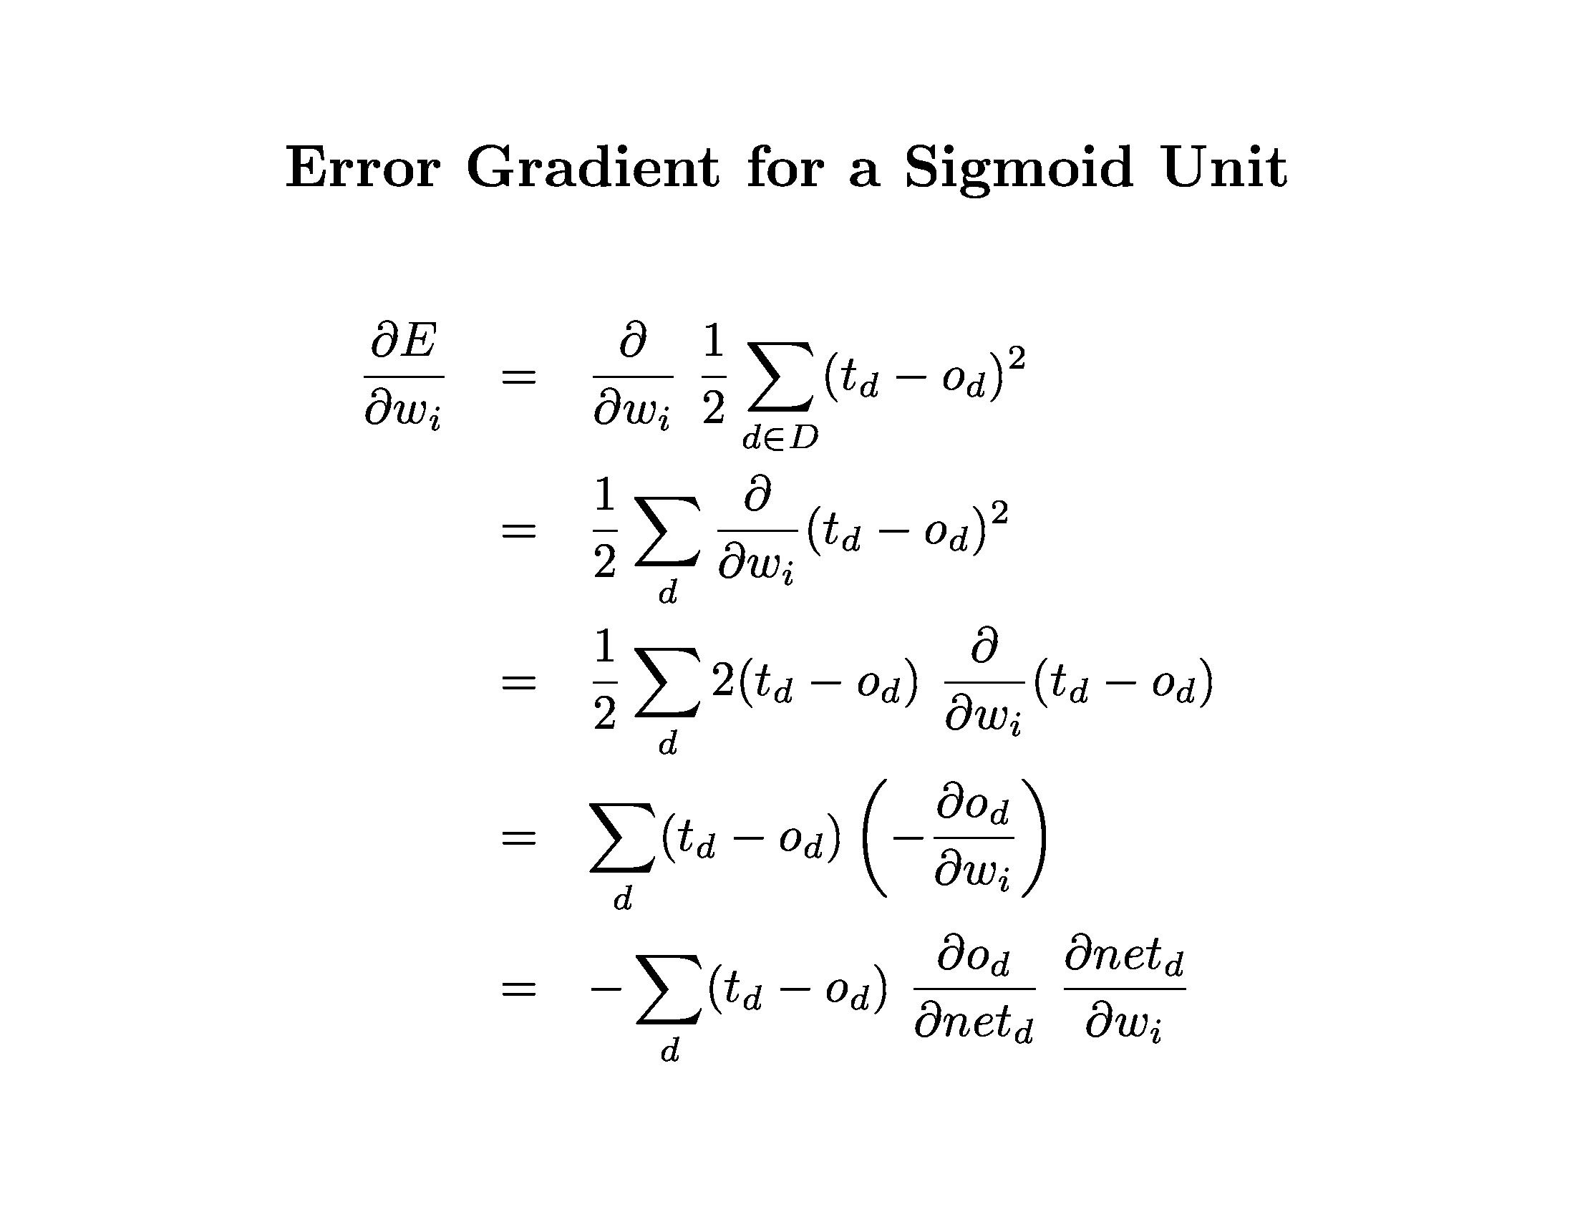
Neural Networks

Slide 24
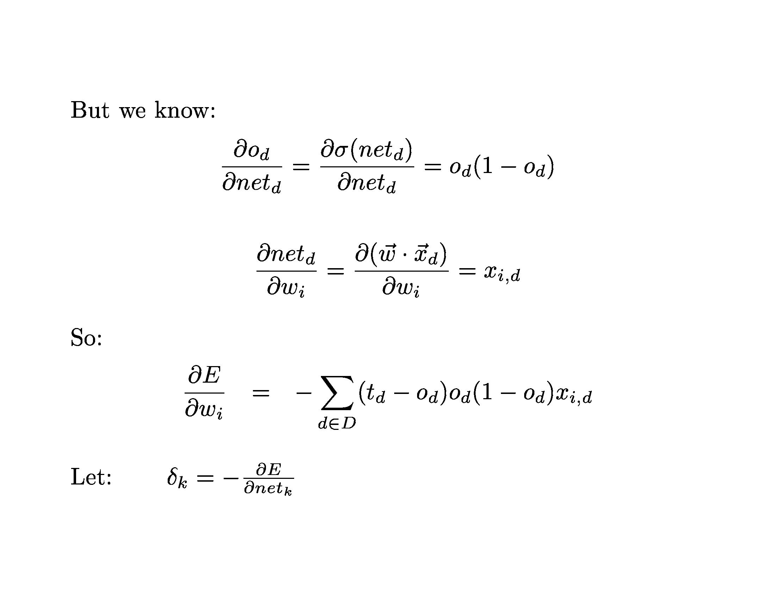
Neural Networks

Slide 25
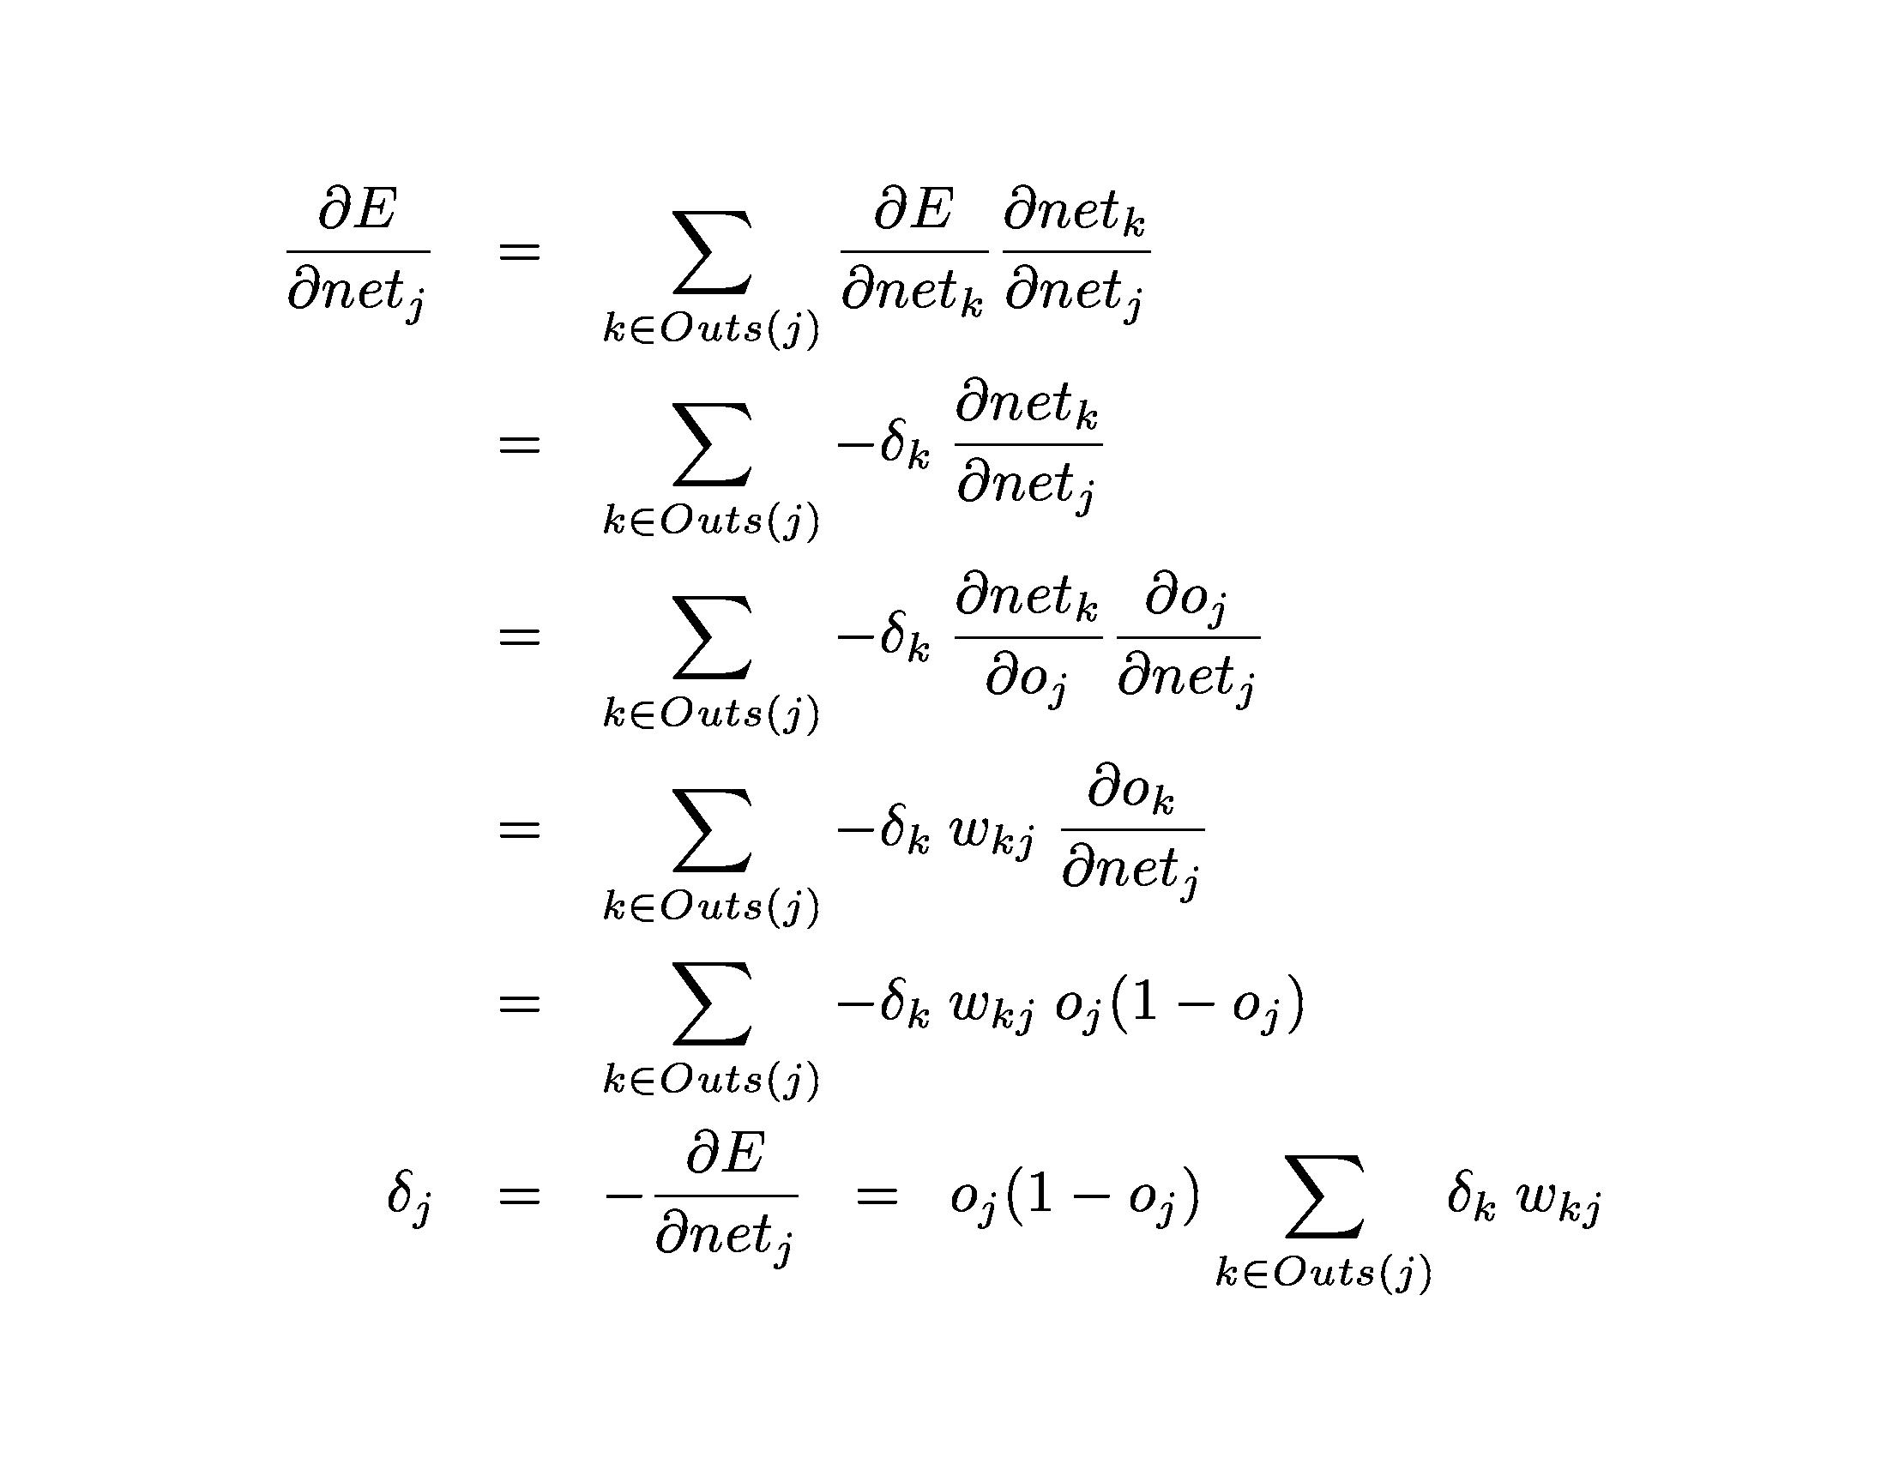
Neural Networks

Slide 26
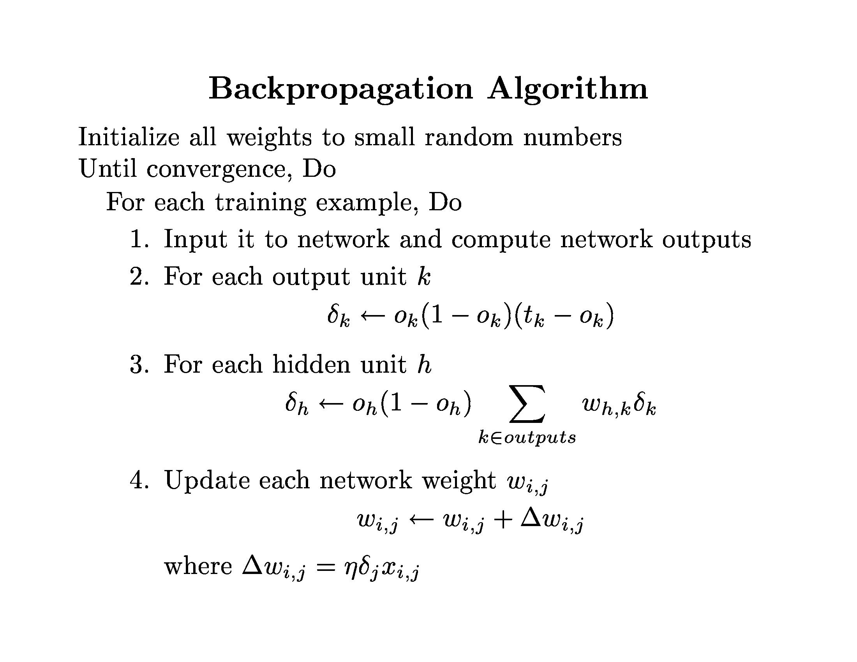
Neural Networks

Slide 27
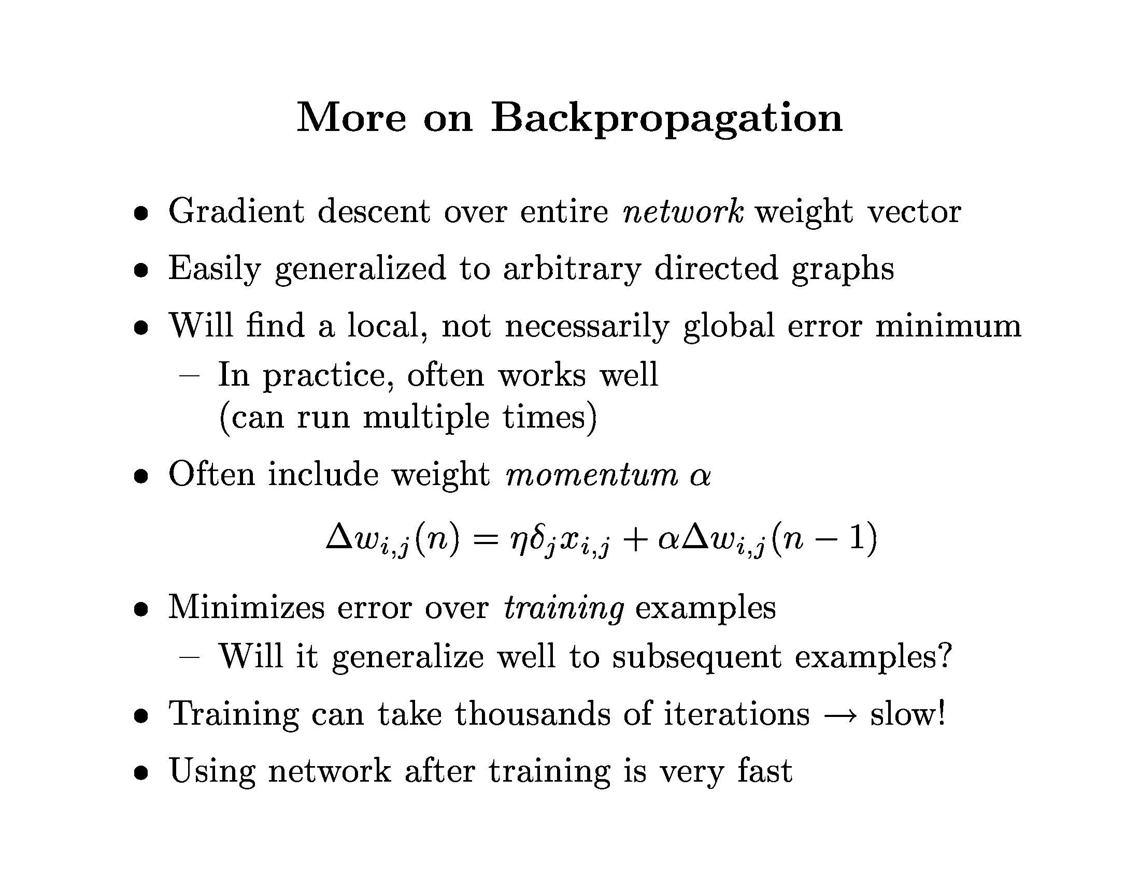
Neural Networks

Slide 28
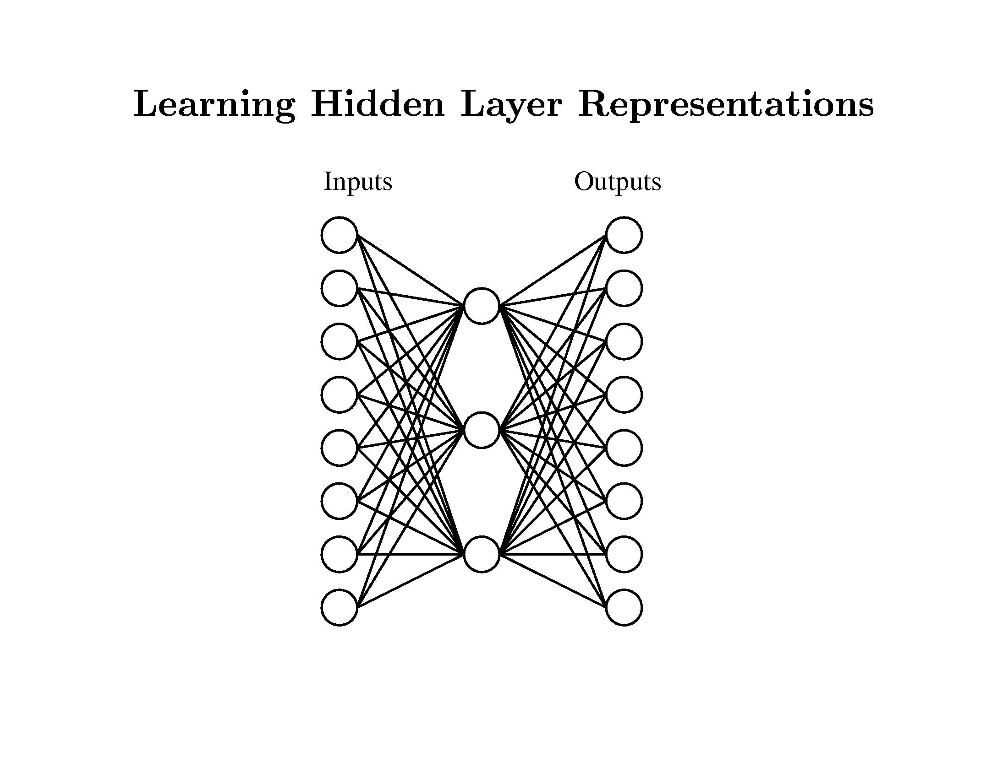
Neural Networks

Slide 29
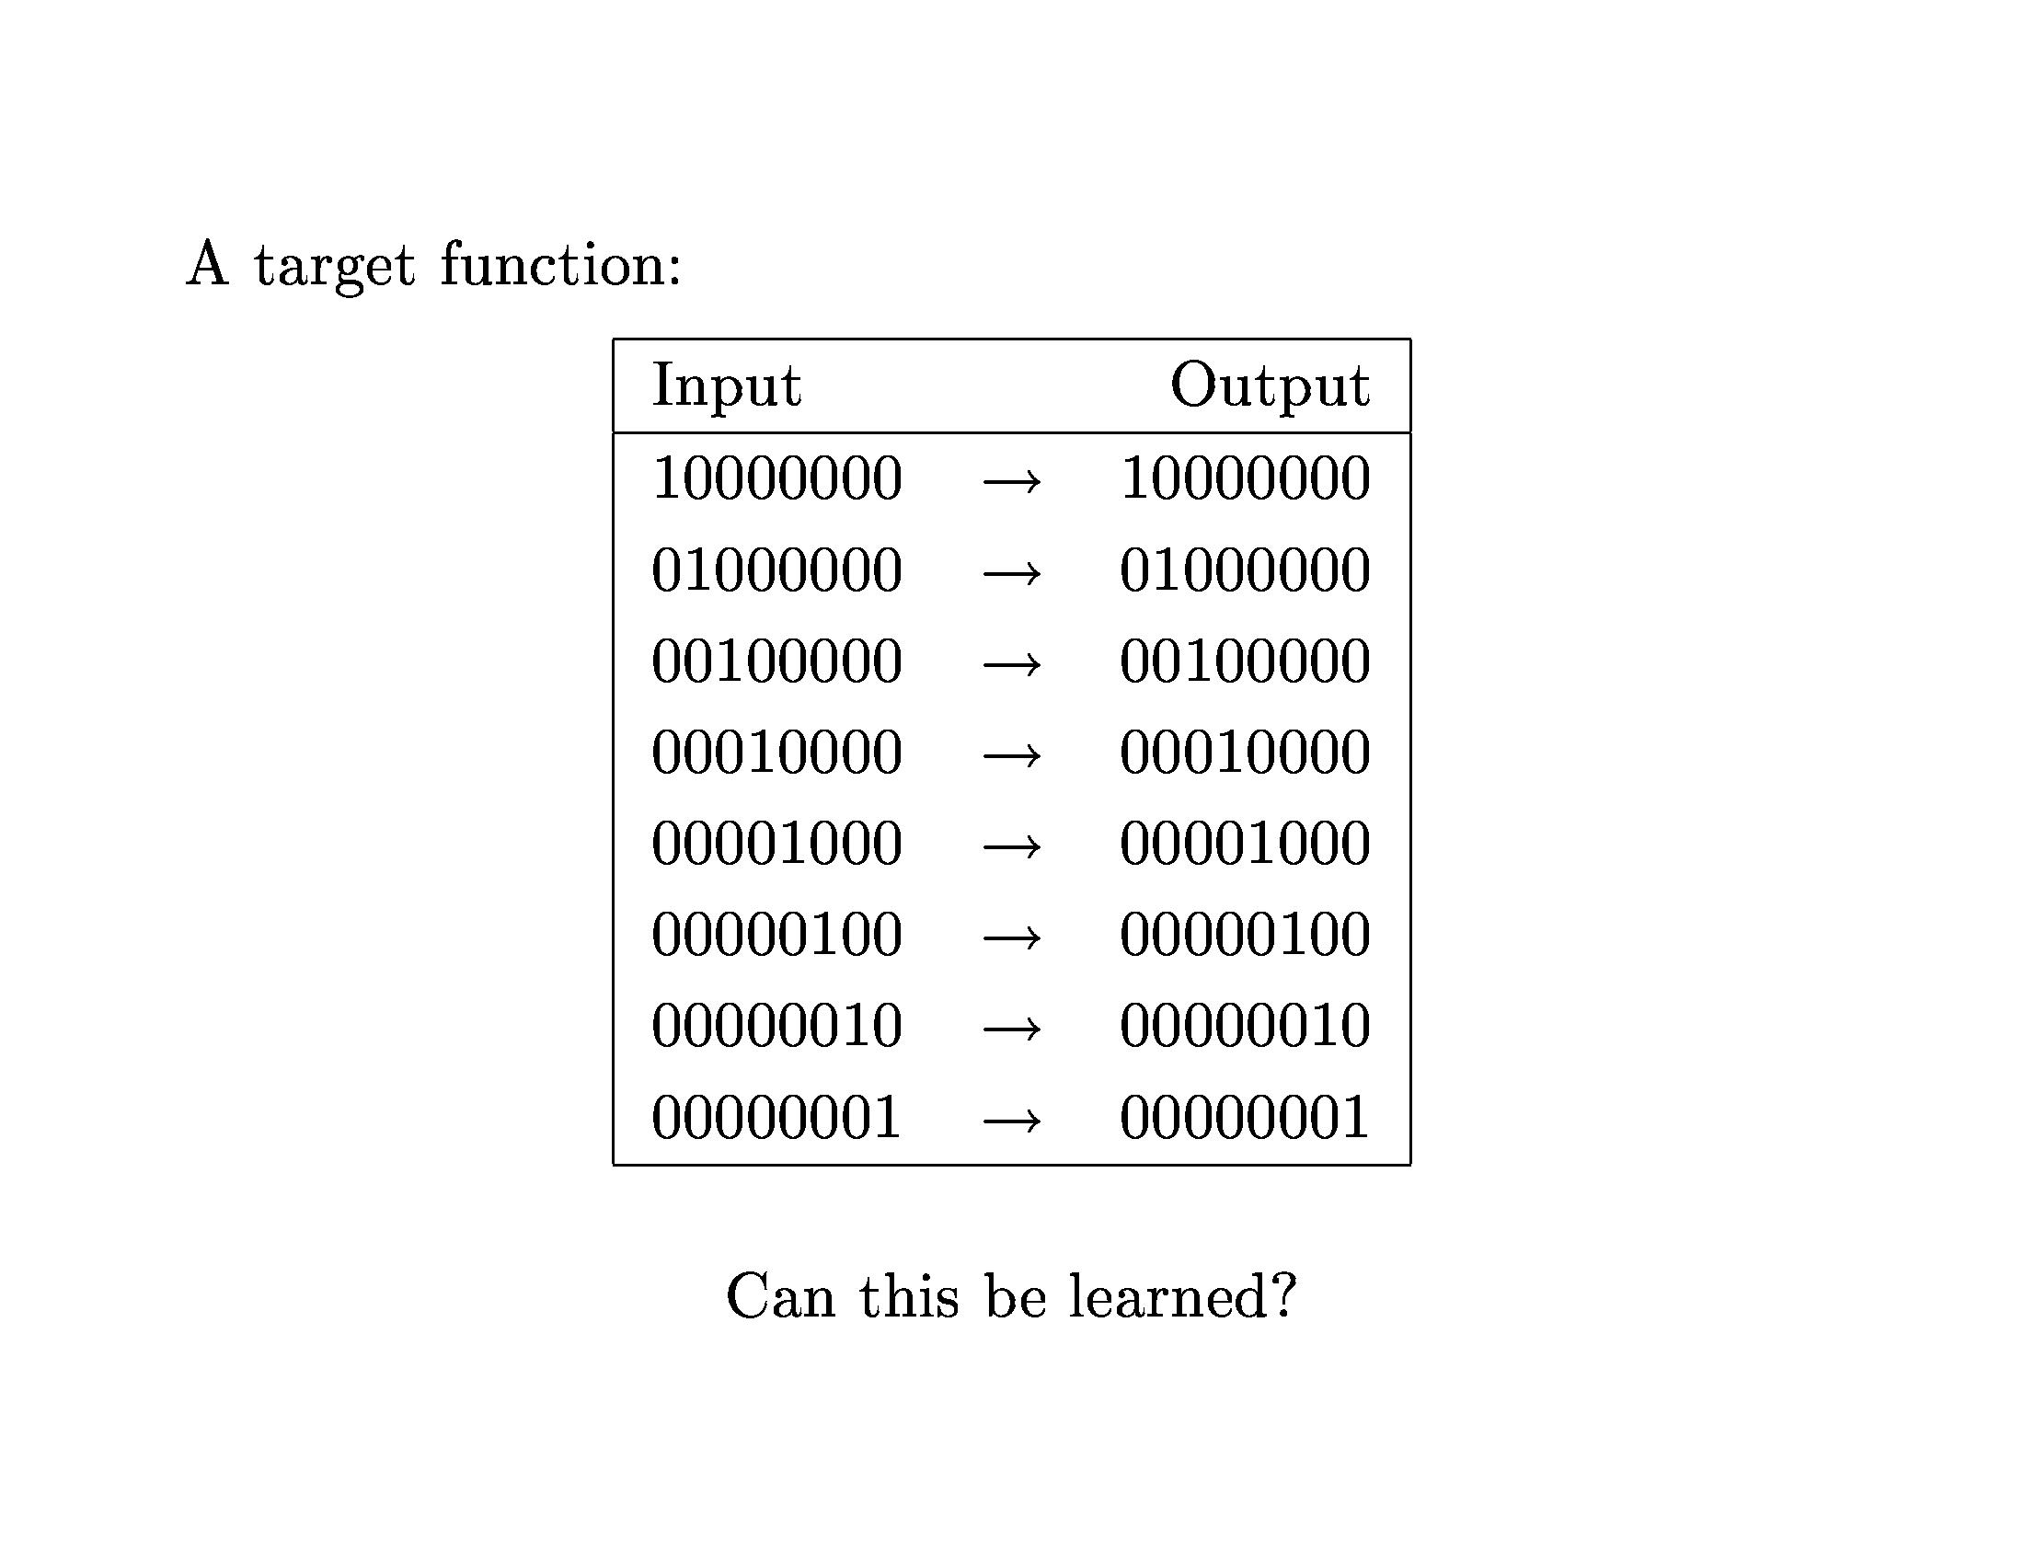
Neural Networks

Slide 30
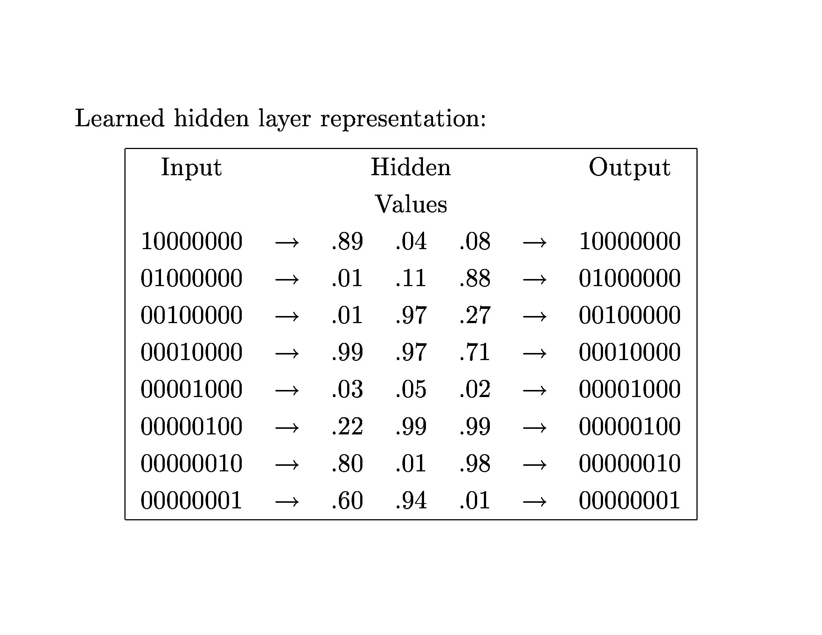
Neural Networks

Slide 31
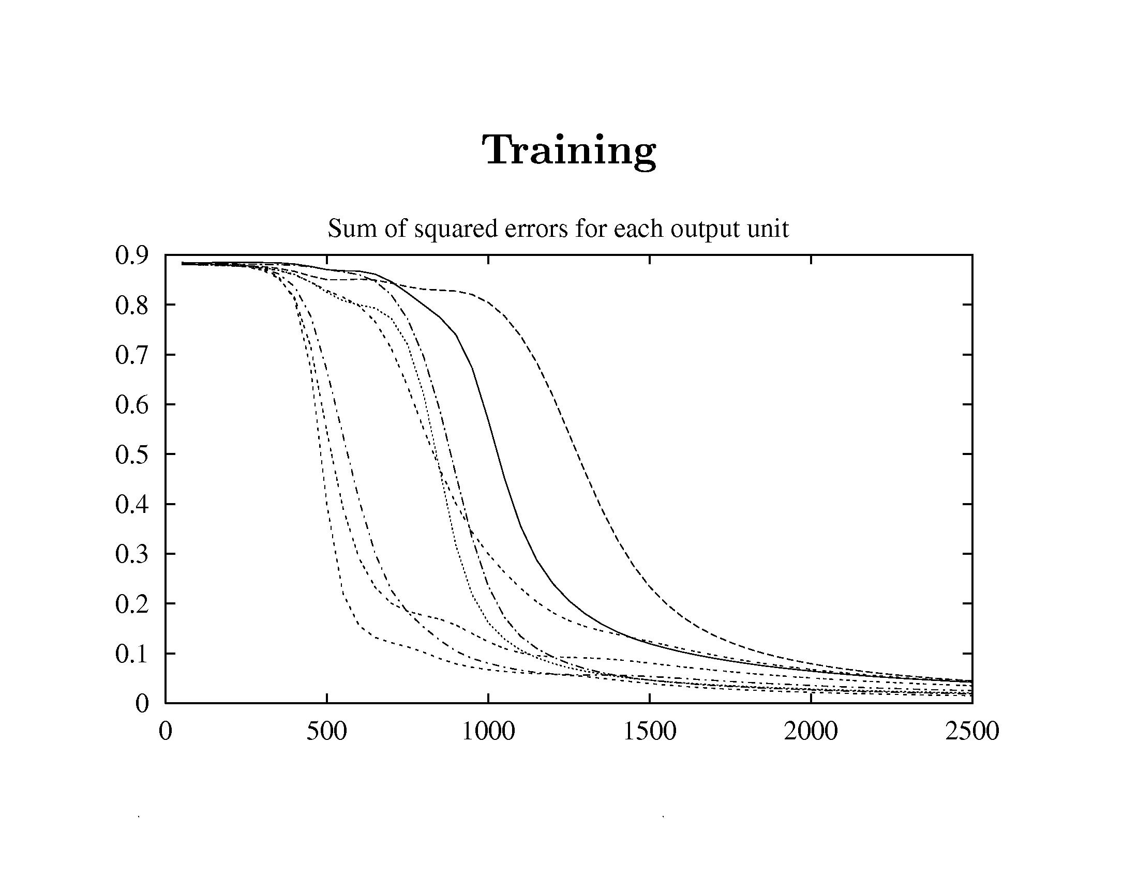
Neural Networks

Slide 32
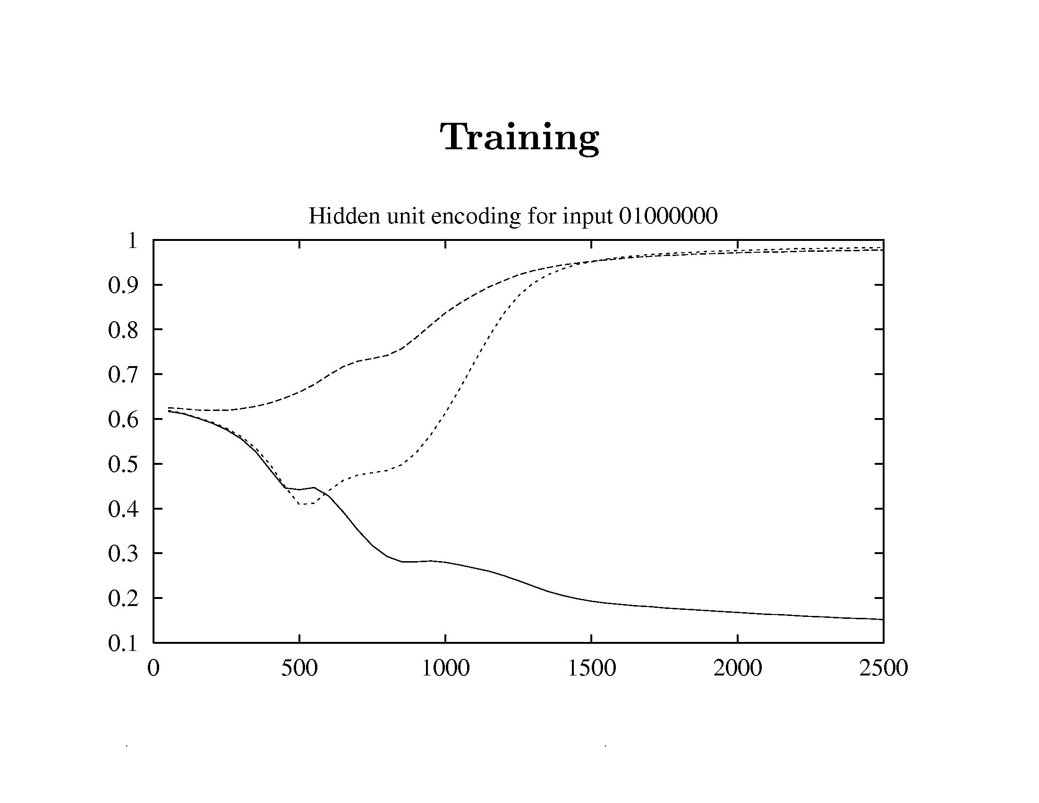
Neural Networks

Slide 33
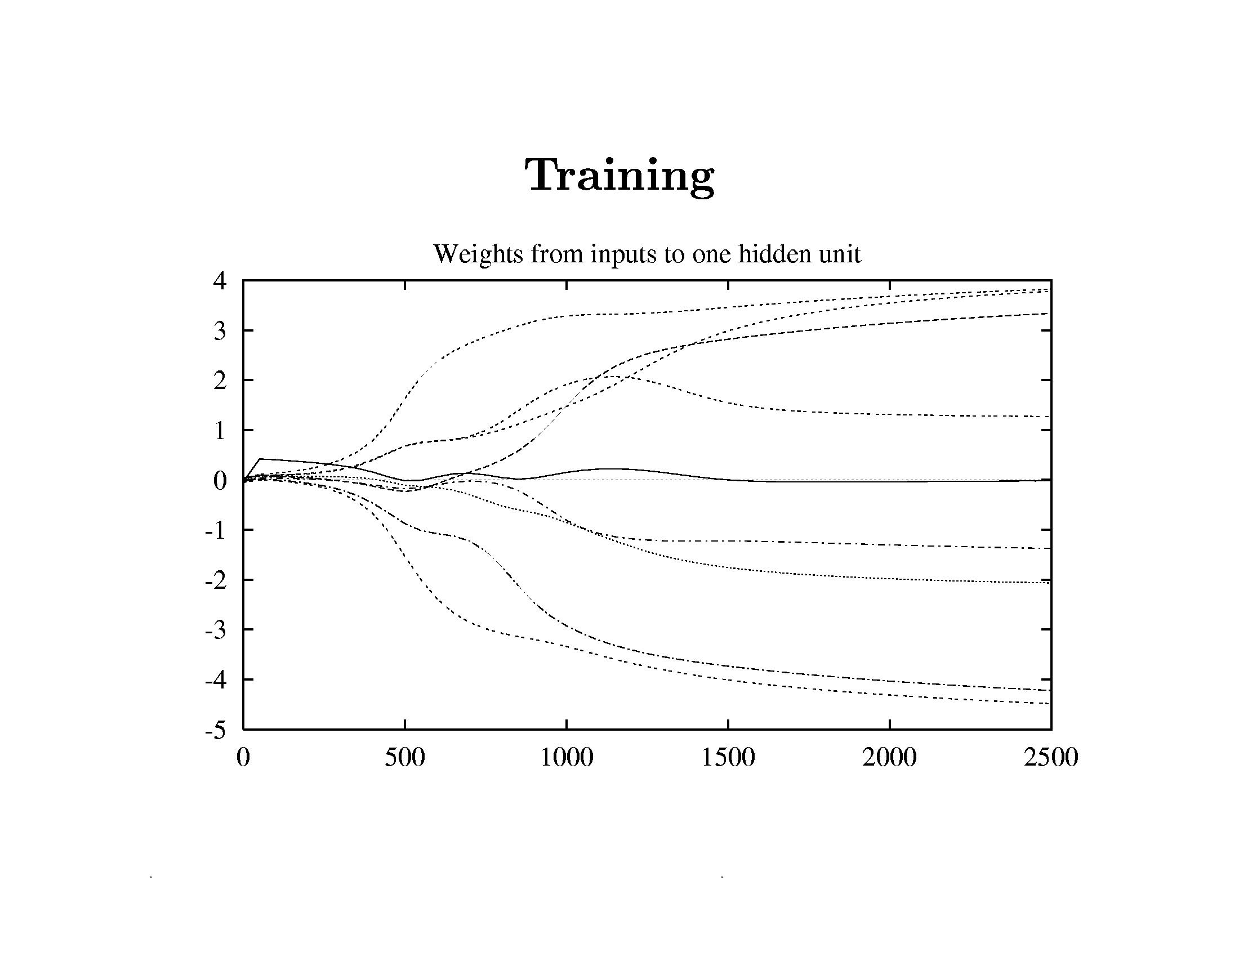
Neural Networks

Slide 34
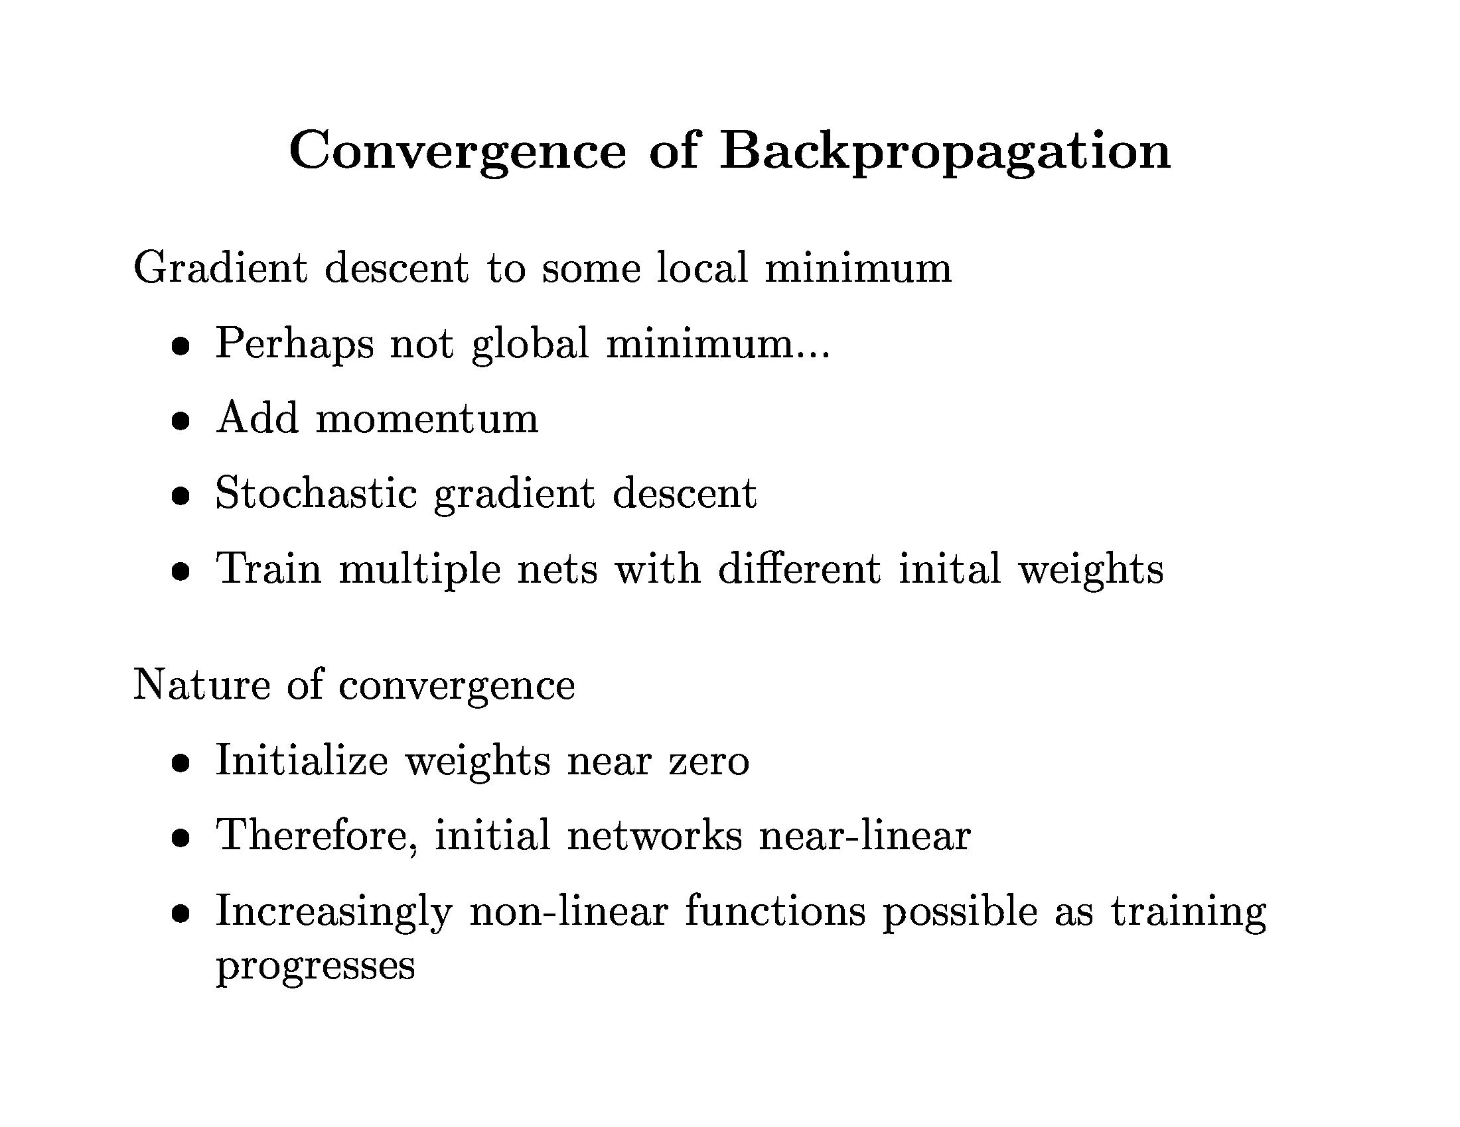
Neural Networks

Slide 35
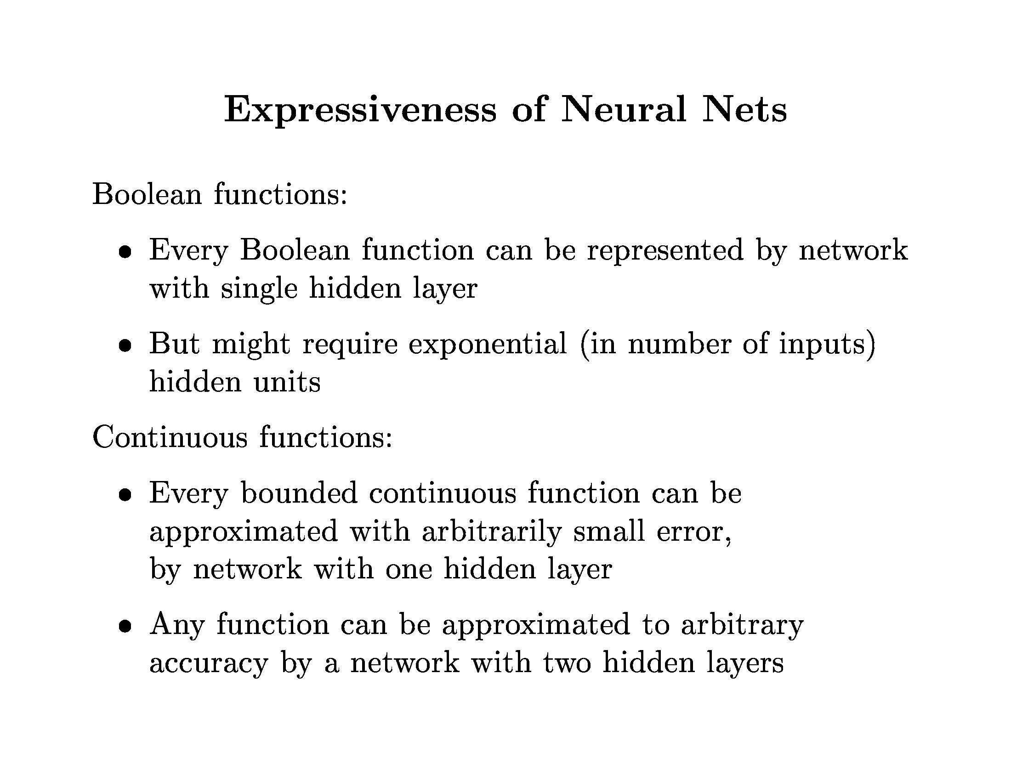
Neural Networks

Slide 36
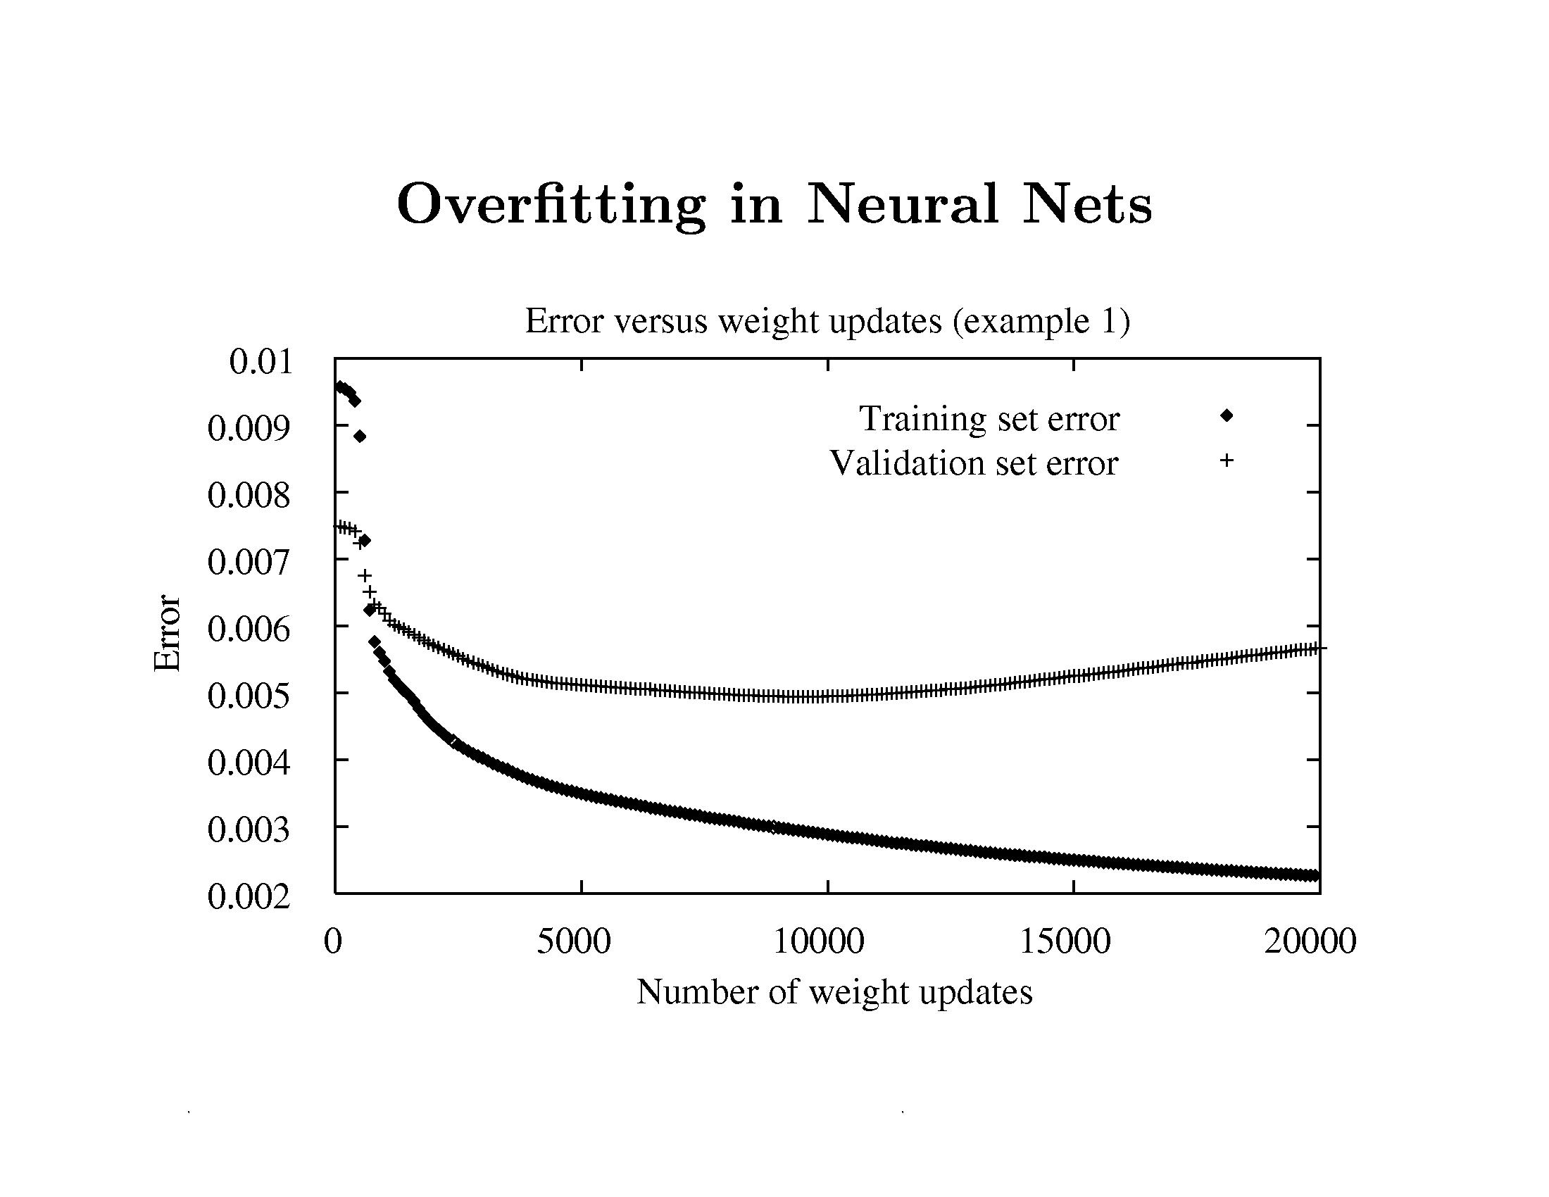
Neural Networks

Slide 37
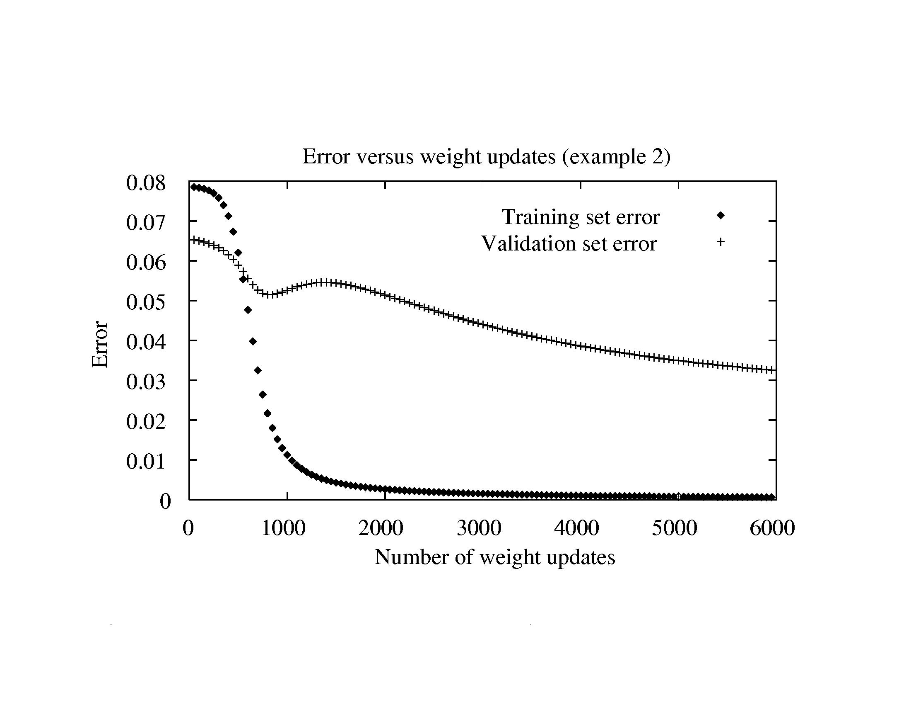
Neural Networks

Slide 38
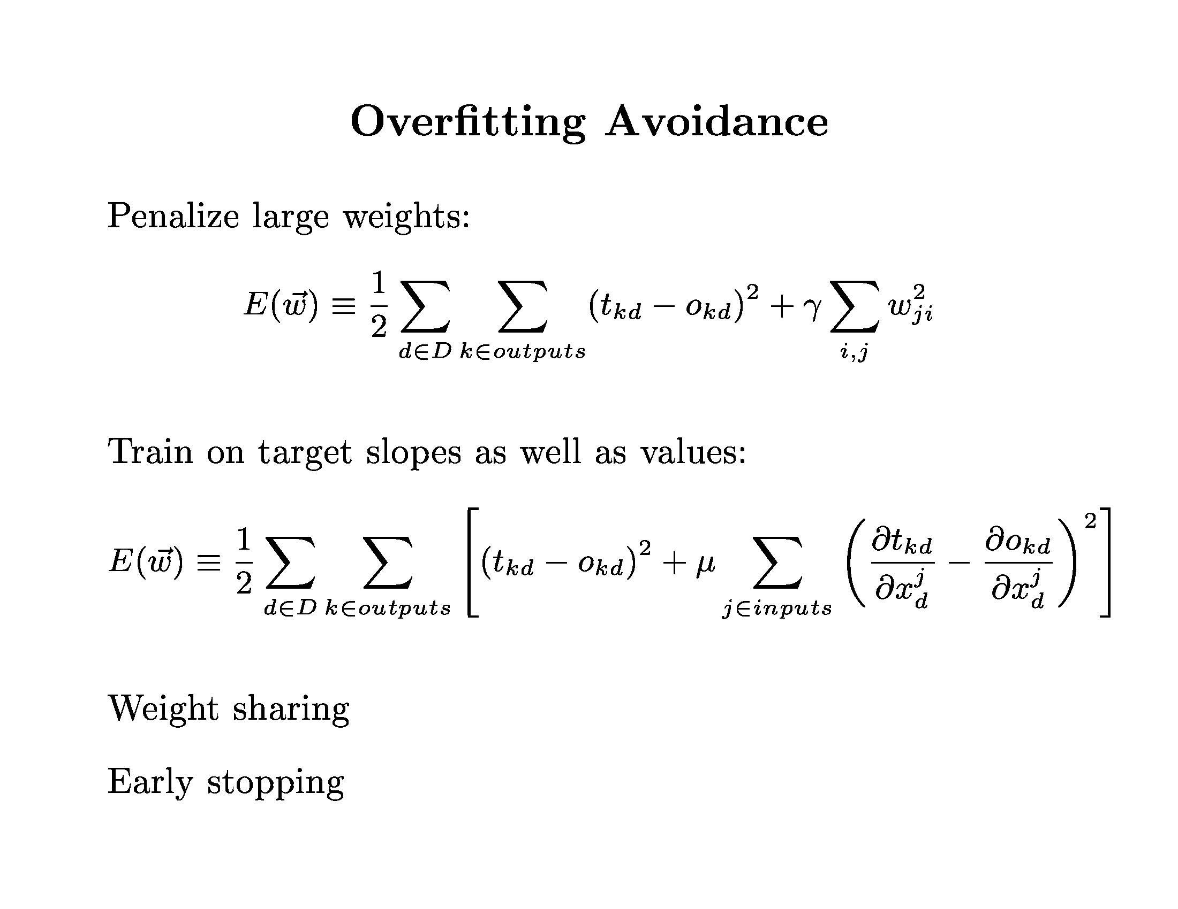
Neural Networks

Slide 39
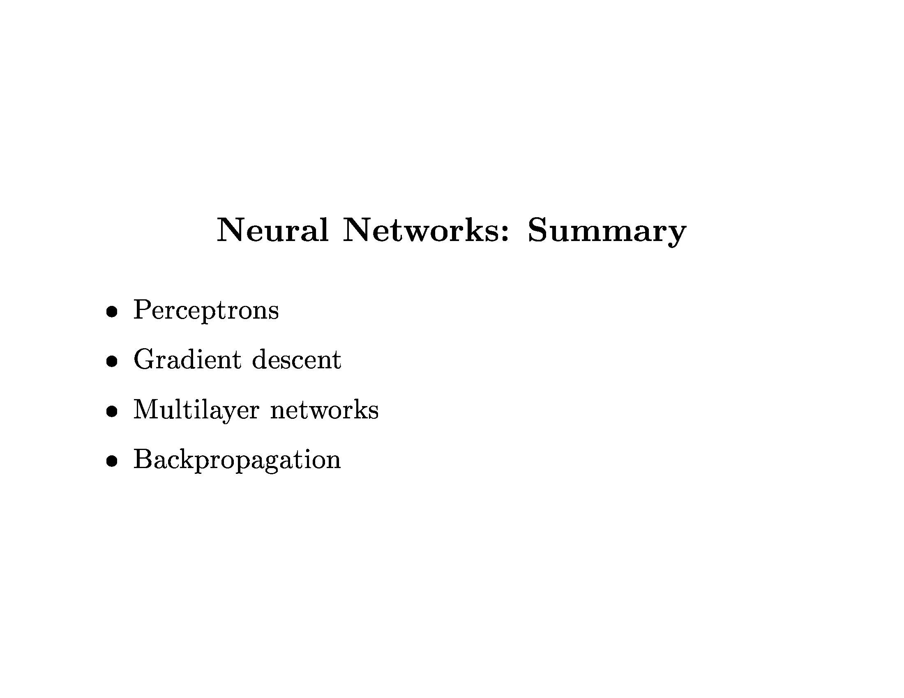
Neural Networks

Slide 40
Neural Networks
Exercise: Neural Networks

